Slide 1

U.S. Army ATR Training Program
10 US Code 2302 (PL 102-484, S326)
Army Acquisition Executive Environmental Support Office

Slide 2
Army Dependency
on ODS …
In Weapon Systems and Equipment Is a
READINESS ISSUE
The Goal of the Army ODS Program Is to
ELIMINATE ALL DEPENDENCY
ON ODS – CLASS I AND II

Slide 3
Part 1
What is the Ozone Layer?
  Response to Concerns
    Army Applications

Slide 4
What Is the
Ozone Layer?
Stratospheric Ozone
Discovery of Ozone Depletion
Ozone Depleting Substances
Typical ODS
DoD Share of Ozone Depletion

Slide 5
Ozone Layer
Stratospheric Ozone
Oxygen radical (O₃ )
Ground Level = Smog
30x Concentration @ 12-19 Miles
  Reflects Harmful UV-B Radiation
  “Cools” the Atmosphere
O
O
O

Slide 6
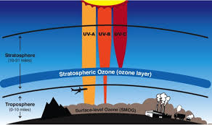
Ozone Layer
10,000 ppb
98% UV-B
200 DU (1980)
75 DU (1995)
115 DU (2014)

Slide 7

Ozone Layer
Discovery of Ozone Depletion
1970s -- CFCs Used as Tracers
-- Study of Cl Rx w/Ozone
1980s -- CFCs Longevity in Air
-- Ozone Column
1990s -- Direct Measurement --
-- “Ozone Holes”
-- Computer Models
-- Start of Public Outcry

Slide 8
Ozone Layer
CFCs
BrFCs
OZONE
DEPLETING SUBSTANCES
HBrFCs
HCFCs
Fire Suppression
Refrigeration/Air-Conditioning
Cleaning/Degreasing

Slide 9
Ozone Layer
Typical ODS
Fire Suppressants: Halon 1211, Halon 1301
Refrigerants (Class I): R-11, R-12, R-500, R-502
Refrigerants (Class II): R-22, R-123
Solvents (Class I): Methyl Chloroform, CFC-113
Solvents (Class II): HCFC-141b, HCFC-225

Slide 10
DoD ODS Use in 1986 vs Total U.S. Production
Ozone Layer
SOURCE: Alliance for Safe CFC Policy

Slide 11
Response to Concerns
Montreal Protocol
Clean Air Act Amendments of 1990
Defense Authorization Act for FY93
DoD Directive 6050.9
U.S. Army
General Officers Steering Committee
HQ DA LTR 200-90/92-1 (expired)
Strategic Guidance & Planning
AR 200-1 & AP 200-1
Policy Memoranda

Slide 12
Response to Concerns
Montreal Protocol
International Treaty to Protect Ozone Layer
Signed by 24 Nations - September 1987
Ratified by US Senate - April 1988
      London Amendment
      Copenhagen Amendments
      Vienna Amendments

Slide 13
London Amendments
September 1990
Response
to Concerns
Signed by 68 Nations
Added Phase-out Schedule
  Halons / CFCs - 2000
  Carbon Tetrachloride - 2000
  Methyl Chloroform - 2005
  HCFCs (Class II) - 2020

Slide 14
Copenhagen Amendments
November 1992
Response
to Concerns
Accelerated Production Phase-outs
  Halons 01 Jan 94
  CFCs 01 Jan 96
Expanded Controlled Substances
  34 HCFCs (phase-out by 2030)
  34 HBFCs (phase-out by 1996)
  Methyl Bromide

Slide 15
Vienna Amendments
December 1995
Response
to Concerns
Requirements for Developing Nations
Accelerated Phase-out for Developed
  Methyl Bromide 2010
  HCFCs* 2020
* 10-year service tail for existing equipment

Slide 16

Montreal Amendments
September 1997
Response
to Concerns
Moved Forward the Phase-out of Methyl Bromide from 2010 to 2005
Added Licensing Requirements for Use
of New/Used/Recycled/Reclaimed ODS
Added Compliance Procedures for Calculating Consumption

Slide 17

Beijing Amendments
December 1999 (adjusted 2007)
Response
to Concerns
Added Bromochloromethane and Established the Phase-out for 2002
Expanded Compliance Procedures for Calculating CFC/HCFC Compliance

Slide 18

Kigali Amendments
October 2016
Response
to Concerns
U.S. Is a Signatory to the Amendment but Congress Did Not Ratify
Added HFC Greenhouse Gases (GHG)
- HFCs Are Not ODS
- Set Cap at 90% 2011-2013 Baseline
- Set Graduated Reduction Schedule
- Set Target (15% of Baseline) at 2036

Slide 19
Clean Air Act Amendments (1990)
Title VI - Stratospheric Ozone Protection
Response
to Concerns
Class I ODS
  CFCs / Halons
  Carbon Tetrachloride
  Methyl Chloroform
  HBFCs
  Methyl Bromide
Class II ODS (HCFCs)
Production Phase-outs
  CFCs 31 Dec 95
  Halons 01 Jan 94

Slide 20
National Defense Authorization Act for FY93 (PL102-484) Section 326
Response
to Concerns
Congress Directed DoD to:
Review Contracts for Class I ODS
Determine if Can be Replaced
Allow Class I ODS in Contract
only with the Approval of a
Senior Acquisition Official

Slide 21
DoDD 6050.9
13 February 1989
Response
to Concerns
Identify Class I ODS Use and Criticality
Implement Conservation Measures
Conduct Research and Development
Eliminate ODS from MILSPECs/STDs
Buy & Store for Critical Applications
Cancelled in 1998

Slide 22
Response to Concerns
Army General Officer Steering Committees
07 July 89
30 April 90
19 December 91
Pursue Joint Research
Support Industry Programs
Fund Army R&D as a
Last Resort

Slide 23
HQDA LTR 200-92-1
27 July 1992
Response
to Concerns
Implemented DoD 6050.9
  Identified Army Responsibilities
    Established 21 Separate Policies
      Incorporated into AR 200-1
        EXPIRED

Slide 24

Response
to Concerns
FRAMEWORK FOR
PROGRAM EXECUTION
Strategic Guidance and Planning
for
Eliminating Ozone-Depleting Chemicals
from
U.S. Army Applications
Assists in the Planning Process
Articulates Army ODS Policy
Provides Implementing Guidance
Identifies ODS Project Leadership
Integrates All Army ODS Efforts
U.S. ARMY
ACQUISITION POLLUTION PREVENTION
SUPPORT OFFICE

Slide 25
Response
to Concerns
Army Regulation 200-1
21 March 1997
Eliminate Class I ODS by FY04
  Comply with PL 102-484, S326
    Document Requirements thru EPR
      Plan to Eliminate Class II ODS
UPDATED 13 December 2007
4-1.a.(3) Air Resources Policy
Eliminate dependency on ozone depleting substances.

Slide 26
Response
to Concerns
Early Policy Memos
AAE, Implementation of
PL 102-484 S 326, 20 May 93
DASA(ESOH), Disposition of Excess
ODCs at Army Installations, 18 Oct 94
ASA(IL&E), ODC Elimination at Army
Installations, 13 Feb 96

Slide 27
Response
to Concerns
ACSIM Policy Memo
Elimination of the Dependency on
ODCs in Army Facilities, 3 Jul 1997
Commanders Responsible
Tenants Responsible to Comply
Class I ODS Out by the End of FY03
All Army Class I ODS Must Be Recovered
Alternatives Must Have EPA, ASG Clearance
No ODS in a Contract without SAO Approval

Slide 28
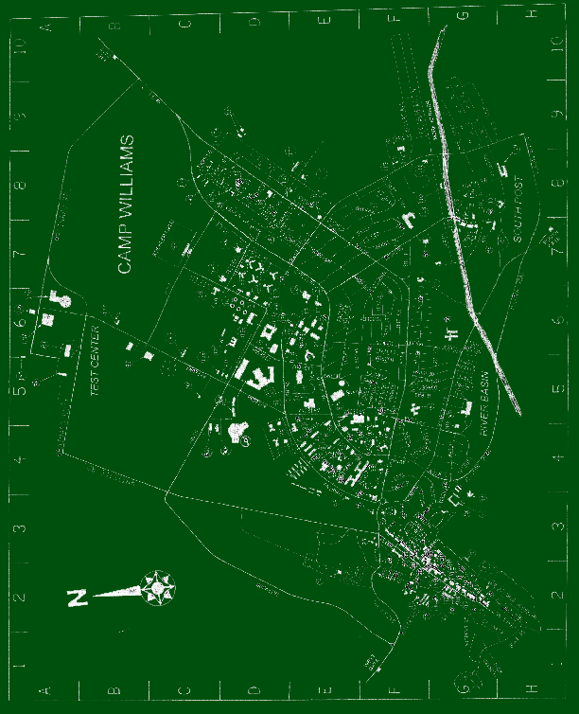
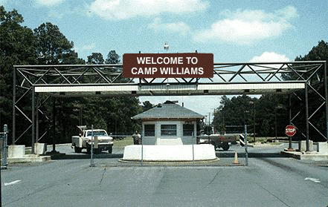
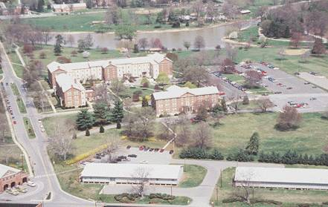
Response
to Concerns
ACSIM Policy Memo
14 January 1999
Installations Must Have
ODS Plans by End of FY00
MACOMs Must Report
Status EOY 1999 & 2000
Class I ODS Use Must Be
Eliminated by 1 Nov 2003
Guide to Preparing
Ozone-Depleting Chemical
Elimination Plans
for Installations
Prepared for: Army
Acquisition Pollution Prevention Support Office

Slide 29
Response
to Concerns
AAE Policy Memo (I)
Eliminating the Dependency on ODCs
in Army Weapon Systems, 18 May 2000
Program Managers Responsible
No Class I ODS in New Systems
Alternatives Must Be AAE Approved
No ODS Solvent to Be Required or Used
All Class I ODS Must Be Recovered, Reused
Alternatives Must Have EPA, ASG Clearance
No Contract Can Require an ODS w/o Approval

Slide 30
Response
to Concerns
AAE Policy Memo (2)
Minimizing the Use of Ozone Depleting
Substances, 8 April 2013
No ODS in New Systems
No ODS from Reserve for FMS
No ODS Solvent Required or Used
No Buying Class II Refrigerants after 2014
Class I ODS Must Be Recovered – No Venting
SAO Approval Authority Delegated to PEOs
All Contracts Must Be Reviewed, Even COTS
PMs Using ODS Report Annually thru DASCs

Slide 31
Response
to Concerns
AAE Policy Memo (3)
Ozone Depleting Substances and Their
Alternatives, 17 May 2018
Units Authorized to Use ODS
No ODS from Reserve for FMS
No ODS in New Weapon Systems
No Commercial Procurement of Refrigerants
No Venting ODS or Hydrofluorocarbons (HFCs)
COTS, SBIR, software and services contracts
without MILSPECs do not require ODS review
Cannot reinstall expired hydro-test fire bottles
Must remove portables w/expired service lives

Slide 32
Army ODS
Applications
FIRE SUPPRESSANTS
REFRIGERANTS
SOLVENTS

Slide 33
Class I ODS
Applications
HALONS
Fire & Explosion Protection
CFCs
Air Conditioning & Refrigeration
General Surface Cleaning

Slide 34
Halon
Applications
Ground Combat Vehicles
  Watercraft Engine Rooms
    Aviation Nacelles
        Facilities

Slide 35
Ground
Combat Vehicles
Crew Compartment Explosion Protection
  Combat Survivability
Engine Compartment Fire Suppression
Abrams Handheld Fire Extinguishers

Slide 36
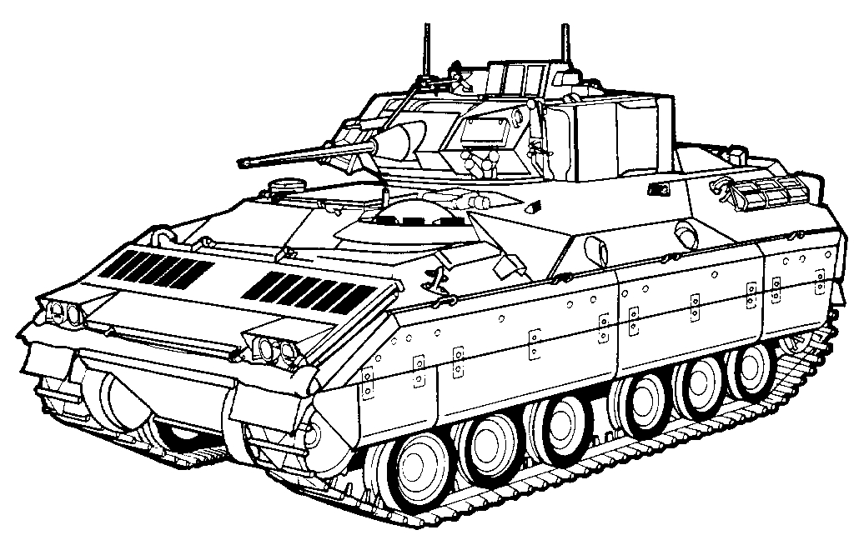
Ground
Combat Vehicles
M1 ABRAMS NBC FOX
M2/3 BRADLEY M9 ACE
M109 PALADIN
M551 SHERIDAN
M992 FAASV

Slide 37
Aviation
CH-47
UH-60
AH-64
MI-24
Engine Nacelles
UH-1 EO-5 AH-6
RC-12 C-20 C-27
C-31 UC-35 C-37
CH-47 OH-58 UH-60
AH-64 TH-67 UH-72
Hand-held
Fire
Extinguishers

Slide 38
Watercraft
Landing Craft Utility (LCU) 1600
Landing Craft Utility (LCU) 2000
Landing Support Vehicle
Inland & Coastal Large Tug
D O N E
Machinery Spaces
Flammable Storage

Slide 39
Facilities
Computer and Data Storage Rooms
Telecommunications Areas
Electronic Switch Gear Rooms
Uninterrupted Power Source (UPS)
Flight Simulators
D O N E

Slide 40
Halon
Categories
RESERVE SUPPORTED
Armor Turret/Crew Areas
Armor Engine Compartments
Aviation Engine Nacelles
Watercraft Engine Spaces
Handheld Fire Extinguishers *
NOT RESERVE SUPPORTED
        Facilities Fire Suppression

Slide 41
CFC
Applications
FACILITIES
FIELDED SYSTEMS
D O N E
Air-Conditioning
Refrigeration

Slide 42
Air
Conditioning
Facilities
Commercial
Industrial
D O N E
Tactical Shelters
Tactical Vehicles
Watercraft
Fielded Systems

Slide 43
Refrigeration
Cold Storage
Household
Kitchen Equipment
Facilities
D O N E
Food Service
Hospitals
Water Chillers
Fielded Systems

Slide 44
CFC
Categories
RESERVE SUPPORTED
HMMWV Ambulance
NON-RESERVE SUPPORTED
        Field Refrigeration
        Facilities A/C & Refrigeration
D O N E

Slide 45
Solvent
Applications
Electronics Maintenance
General Metal Cleaning
Precision Metal Cleaning
Ordnance Manufacture
NBC Testing
D O N E

Slide 46
Solvent
Categories
RESERVE SUPPORTED
Nothing
NON-RESERVE SUPPORTED
        Everything
D O N E

Slide 47
Class II ODS
Applications
Halon Alternatives
Engine & Flightline Fire Suppression
HCFCs
Air Conditioning & Cooling
Precision Cleaning

Slide 48
Class II ODS
Applications
R-22 IN
FACILITIES AND
FIELDED SYSTEMS
Air-Conditioning
Cooling

Slide 49
R-22 Air
Conditioning
Facilities
COTS Building
Rooftop Systems
Fielded Systems
ECUs for Trailers,
Shelters and Tents

Slide 50
R-22 Cooling
Command Centers
Kitchen Equipment
Facilities
Fielded Systems
Support, Training
and C3I Systems

Slide 51
R-22
Categories
RESERVE SUPPORTED
ECUs (most of requirement)
Support, Training and C3I Systems
NON-RESERVE SUPPORTED
        Facilities Air Conditioning

