Slide 2
Technical Module
Natural Resource Protection

Slide 3
Objectives
Understand the importance of protecting natural resources in a base camp and the surrounding area:
  For deploying troops’ safety, health, and reputation
  For local and broader security considerations
  For future generations
Employ practices to minimize negative impact and enhance positive impact
Establish a management process for these considerations
Lack of information and awareness is the primary reason natural resources are damaged
Notes:
There are a number of reasons why it is important to protect natural resources when setting up and operating at a base camp. Showing respect and concern for local natural resources can help ensure the health and safety of the deploying forces, as well as enhance the reputation of the deploying forces in the eyes of the host nation and the international community. Demonstrating this awareness and appreciation can contribute to good relations with the host nation; importantly, failing to show such an appreciation can result in serious strains in the relationship. Finally, it is important to consider the value these resources will have to future generations.
This briefing discusses some of the practices that can be observed to ensure that the protection of natural resources are taken into account. It offers examples of the positive impact that such practices can have, and of the negative impact when these resources are not protected. As many of these examples illustrate, often it is the lack of information that can lead to unintended consequences. Having the necessary information available is an important first step.
This briefing emphasizes the importance of having a management process in place to take these considerations into account.

Slide 4
What Natural Resources Need to be Protected?
Water resources
Wildlife, especially protected and endangered species
Flora and fauna
Minerals and other non-renewable resources
Habitat (soil, water, airspace)
  eco-systems
  critical habitats
  conservation areas
  bird areas
  migration routes
Notes:
One of the most precious resources, which is often overused during operations, is water. Water is used not only for drinking, but food preparation, sanitation, cleaning of equipment, dust suppression, etc. It is vital that deploying forces adopt practices that support the sustainable use of water. Similarly, the depletion of minerals and other non-renewable resources can directly impact operations.
“Natural resources” also encompass wildlife; flora and fauna; and the habitats in which they live. In terms of these types of natural resources, of particular concern are those that have been designated as “protected” or “endangered.”

Slide 5
Why Should You Care?
Protection of natural resources in a base camp can:
  Support sustainability of these resources, such as water
  Preserve unique and endangered resources that can be of worldwide significance
  Foster good will from local government and community
  Maintain local community and potential future tourism assets
Failure to do so can
  Affect base operations. For example, destroying vegetation can eliminate roots, which stabilize the soil. Soil erosion can mean more funding is needed for construction projects or for stopping erosion in order to protect existing facilities
  Strain relations with the local community or host nation, such as affecting local food and water supplies
  Adversely impact overall sustainability
  Impact climate change
Meeting mission requirements is paramount, but every effort should be made to protect these resources to the extent possible
Notes:
It is important to recognize up front that meeting mission requirements is the paramount priority of the military operation, and the threat level will affect the extent to which natural resources protection can be taken into account. At the same time, it is required by international law to make every effort to protect these resources to the extent possible. What should not be tolerated is the intentional damage and destruction of such resources without any military justification (e.g., soldiers intentionally killing an animal that has been designated as an endangered species as a trophy).
This slide lists a number of the reasons why it is important to care about the protection of these resources. This information is important to convey to all deploying forces. Inadvertent damage to significant (especially protected) natural resources can complicate the attainment of the desired strategic end state through the loss of political goodwill, negative public image, and increased overall cost.

Slide 6
Examples of Laws and Regulations
International examples
  United Nations (UN) Convention on Biological Diversity (1992)
  Convention on International Trade in Endangered Species of Wild Fauna and Flora (CITES)
  United Nations Educational Scientific and Cultural Organization (UNESCO), Convention Concerning the Protection of the World Cultural and Natural Heritage
  European Union’s Natura 2000
Also consider
  Own nation’s laws and regulations
  Those of the host nation
  Mission regulations
Notes:
The UN Convention on Biological Diversity, which came into effect in December 1993, is the main international instrument for addressing biodiversity issues. Its website (www.cbd.int) offers a range of information.
The importance of protecting natural resources is also encompassed in a number of other international documents, several of which are cited here.
It is equally important to know the laws of your own country. For example, the Lacey Act requires that all U.S. citizens must abide by all the wildlife laws of the country they are in as well as by U.S. laws even when they are out of the country. Military personnel are further subject to the Uniform Code of Military Justice for potential violations of General Order I-B, DTR 4500.9-R and CCR 600-10. (These requirements are noted in by the Wildlife Conservation Society in its document, “Wildlife Trade Training Fact Sheet for Military Stationed in Afghanistan or Iraq.”)

Slide 7
Environmental Officer(EO) Responsibilities
Access government intelligence and other information, public documents and websites prior to deployment (e.g., UN’s Convention on Biological Diversity website)
Be familiar with and understand applicable laws and policies (e.g., international, your own nation’s, mission regulations, host nation law)
Work with local, international subject matter experts (SMEs), e.g., Non-governmental organizations (NGOs) (e.g., World Wildlife Foundation, National Geographic Societies)
Identify protected indigenous plants and wildlife and their habitats during base selection and set-up
Create a list of protected natural resources within the base (and area of operations), and keep it updated. Provide this information to the base commander so that troops can be given guidance to try to:
  Avoid adverse effects if possible
  Minimize direct impacts and collateral damage if avoidance is not an option
  Recovery: when natural resources have been damaged, take appropriate responses and reactions
  Maximize respect for and protection of natural resources; this can result in greater mission success
Document information prior to transfer and/or closure of the base camp
Notes:
The responsibility for natural resources protection will likely fall to the environmental officer (EO). It will be important to do whatever research is possible ideally before deployment, to be aware of water availability, wood, sand and gravel for construction, etc. It is also important to know what wildlife, flora and fauna might be in the deployment area, especially those that may be on the protected or endangered list. This slide lists a number of the preparatory steps that should be taken to develop this baseline knowledge. For example, the EO should obtain intelligence and other information from his military organization and/or other government agencies; this can be supplemented by publically accessible documents and websites.
Subject matter expertise about the region where the base is being set up (and in the area of military operations) may be found at the local and national level in the host country (e.g., Ministry of Environment, zoos). There may also be subject matter experts (SMEs) in your own country or in international organizations (e.g., non-governmental organizations that focus on wildlife and natural resources like World Wildlife Foundation (www.worldwildlife.org), Wildlife Conservation Society, National Geographic Societies (at www.nationalgeographic.com, there is also a link to its international offices, www.nationalgeographic.com/siteindex/international). The UN Convention on Biological Diversity website (www.cbd.int) offers a range of reference materials as well.
Once the initial baseline of information is available—both for the base and the area of operations—it is important to keep the base commander apprised of any updates to this information to ensure proper guidance is given to all the troops. The main principles for the troops should be to: avoid adverse impacts if possible; minimize damage if complete avoidance is not possible; when natural resources are damaged, take appropriate action; and maximize respect for these resources. (These points are taken from Laurie Rush, “The Cultural Minefield: A Manual on Cultural Property Protection for the Operator Forward”; as of mid-2013, it is still in draft form. It will likely be available through www.cchag.org)
Finally, when either transferring the base to another command or when closing the base, it is important to document all the relevant information: what natural resources are there (at the base and in the area), their condition, any actions taken to repair any damage, etc.

Slide 8
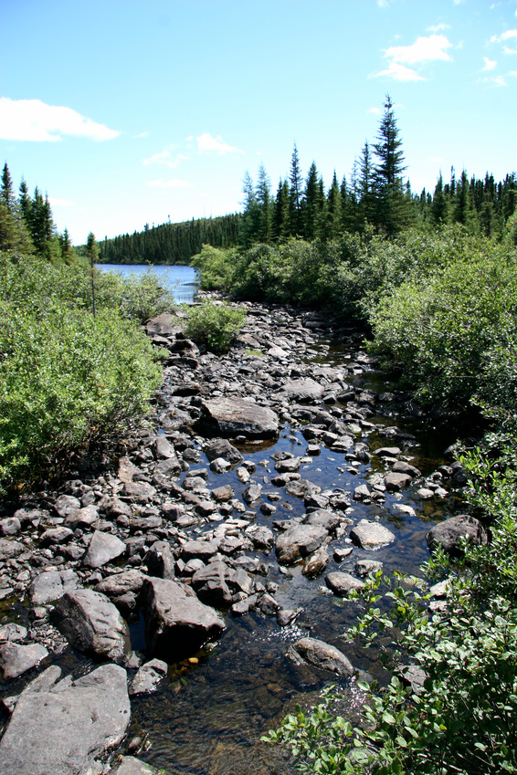
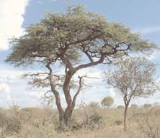
What You SHOULD Do
Adopt sustainable water use practices
Avoid unnecessary destruction of vegetation
Avoid movement in and around sensitive habitats as much as possible
Minimize off-road damage as much as possible
Cross streams only at authorized points
Notes:
There are a number of ways to protect natural resources during deployments. While military operations will sometimes prevent being able to fully take these considerations into account, the more the natural environment can be protected, the better this will be for everyone. This and the following slide suggest ways to conduct your activities to minimize negative environmental impacts.

Slide 9
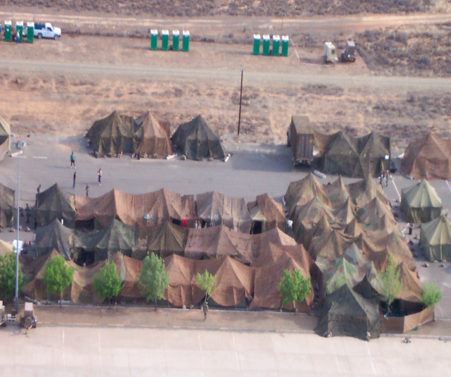
What You SHOULD Do
Refrain from clearing vegetation on steep slopes or along streambeds (this can cause soil erosion)
Prevent base camp from being stripped of vegetation
  Remove only what is necessary for the mission and safety
  Use camouflage nets (instead of branches from live trees)
Encourage water conservation and reuse; use non-renewable resources wisely
Instruct troops to report
injured animals. Provide
guidance on when to
  Seek veterinary help
  Leave in place
  Euthanize

Slide 10
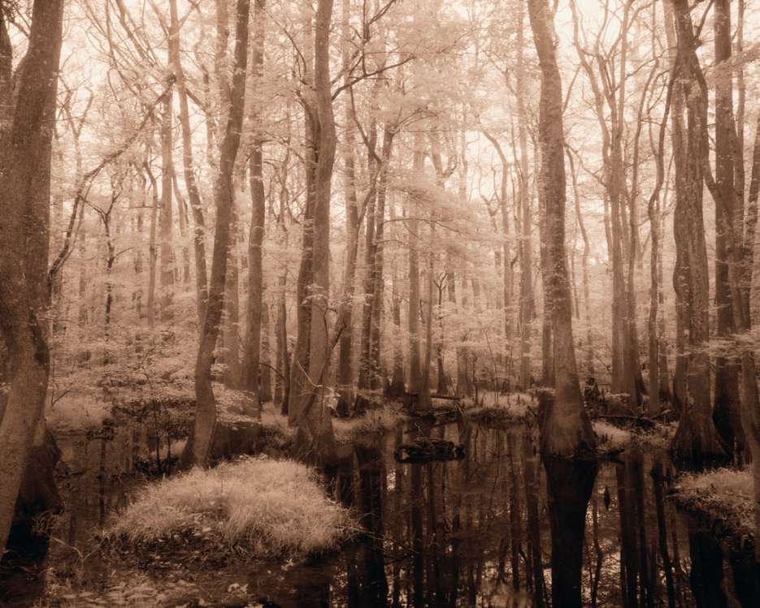
What You Should NOT Do (unless militarily required)
Do not drive directly up steep hills or through wetlands
Do not alter the courses of waterways
Do not take flora or fauna samples
Do not damage trees or habitats unnecessarily
Do not waste resources,
such as overuse of
water or excessive
destruction of vegetation
Notes:
Just as there are a number of ways in which to protect natural resources, there are a number of actions that can have a negative impact. The next several slides offer examples of what should NOT be done, unless it is militarily necessary to do so.

Slide 11
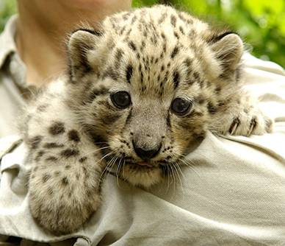






What You Should NOT Do
STOP BUYING WILDLIFE PRODUCTS FROM AFGHANISTAN!
Unnecessarily disturb, capture, hunt or collect as pets any wild animals
Take or buy wildlife products while deployed
There may be fewer than 100 snow leopards left in Afghanistan. If you buy snow leopard pelts, you are violating the law, and driving snow leopards to extinction.
Find out more about the conservation of Afghan wildlife at www.wcs.org/afghanistan.
Notes:
This image is the snow leopard card, available in PDF format through www.wcs.org/afghanistan.

Slide 12
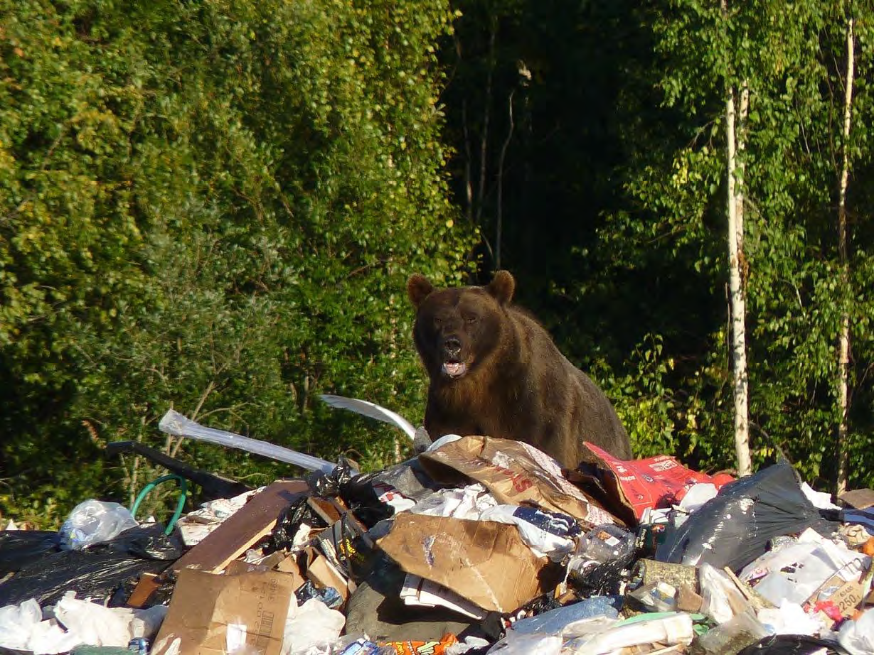
What You Should NOT Do
Do not improperly dump trash—it can attract wild animals, which can present threats to humans (as well as animals)!
Notes:
This picture was taken during a military exercise conducted in 2012; used with permission. It displays a site where contractors supporting the exercise used an open waste dump, which is also used by the local population as part of normal disposal practices in that region. While an accepted practice, and the military use did not cause specific problems, the concern is that such open dumps can attract wild animals, presenting a range of threats to humans and animals alike.

Slide 13
Examples of Wildlife-Related Training Materials
Source: Wildlife Conservation Society (WCS), Military-WCS Projects: Training Materials
www.wcs.org
Notes:
The Wildlife Conservation Society’s website is: www.wcs.org. Information about these training materials for use by the military (specifically focused on those deployed in Afghanistan and Iraq) captured in the following slides can be found at: http://programs.wcs.org/wildlifetrade/Initiatives/MilitaryWCSProjects/TrainingPrograms2/tabid/5451/Default.aspx.
On this page, under “publications,” PDFs of the following documents can be downloaded:
-snow leopard business card
-wildlife trade smart card
-cat fur identification guide
Under the website’s section “Related Content” (just above “publications”), clicking on “pre-deployment training” accesses other resources, guides and information the WCS has created.
The following slides provide “snapshots” from WCS’ website.

Slide 14
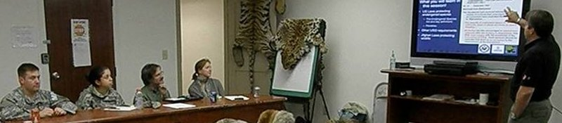
WCS Wildlife Trade
A Programmatic Website
Training Materials
Initiatives > Military-WCS Projects > Training Materials
Snow Leopard Business Card
Business card-sized outreach card that shows a snow leopard, with various reasons listed on the back of why not to buy snow leopard products, as well as a listing of the website.
Wildlife Trade Smart Card
Smart Cards are quick references for soldiers and service members to study and have readily available when needed; pocket cards depict images of wildlife and products focusing on Iraq and Afghanistan. Click here to download a copy.
Wildlife Trade Slide Show
Forthcoming in February 2011. A PDF of Power point slides on wildlife trade products and CITES to be incorporated in pre-departure and in-theater briefings.
Training Fact Sheet
Synopsis of CITES and wildlife trade issues to be distributed to officers prior to departure and in-theater.
Cat Fur Identification Guide Version 1 & Version 2
Two .PDFs of posters used for training military police about how to identify fur from cats. All products containing any amount of cat fur not allowed to be transported across international borders.
http://programs.wcs.org/wildlifetrade/Initiatives/MilitaryWCSProjects/TrainingMaterials.aspx

Slide 15

WCS Wildlife Trade
A Programmatic Website
Training Materials
Initiatives > Military-WCS Projects > Training Materials
WCS Guide to Restricted Species of Afghanistan
A list and photos of internationally recognized protected mammal species in Afghanistan. These are species which cannot be traded.
Program Fact Sheet
Synopsis of the project to be used by the Legacy office for outreach; The Fact Sheet is a required product for all Legacy projects.
Standard Military Form 4856
A military form used by Officers when educating or training subordinates about particular issues. This form is completed with information pertaining to the wildlife trade issue.
Training Videos
A five-minute and 20 minute training video summarizing the key points regarding wildlife trade and the military.
http://programs.wcs.org/wildlifetrade/Initiatives/MilitaryWCSProjects/TrainingMaterials.aspx

Slide 18
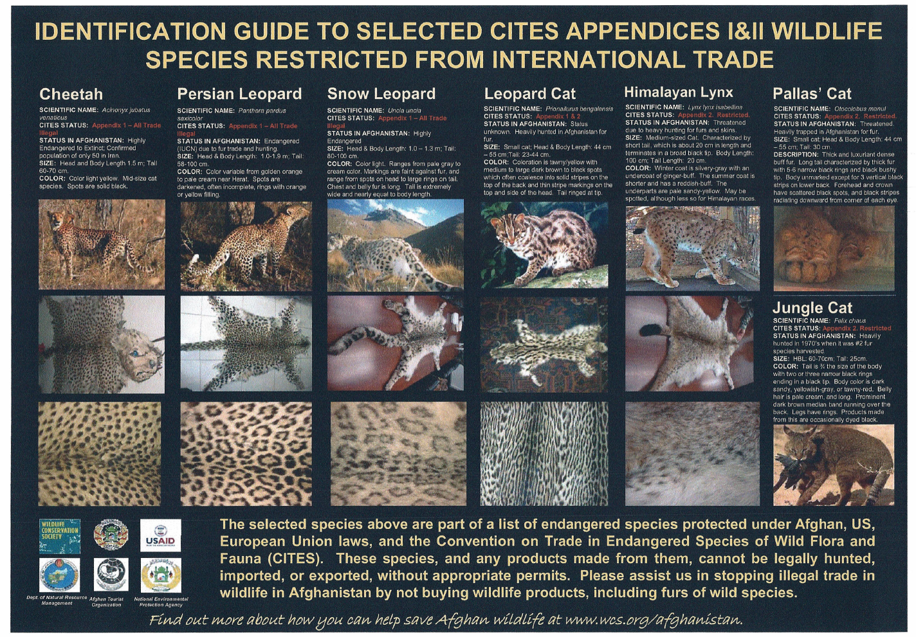
Posters to Raise Awareness
Notes:
This poster is available on www.wcs.org/afghanistan.

Slide 19
Conclusions
Protection of natural resources in a base camp can:
  Support sustainability of these resources, such as water, forests, endangered habitats
  Preserve unique and endangered resources that can be of worldwide significance
  Foster good will from local government and community
  Maintain local community and potential future tourism assets

