Slide 2
Technical Module
Cultural Property Protection
Notes:
The primary international resource for cultural heritage sites is the United Nations Educational Scientific and Cultural Organization (UNESCO), www.unesco.org. Another excellent source of information is www.cchag.org, which includes a downloadable annotated bibliographic database of more than 1,300 books, journals articles and papers, covering historical and cultural property protection in the context of military operations. (The link to this database is under the “in-theater training aids” tab on the home page banner of www.cchag.org.) This website also contains information on what laws may pertain (under the “legal primer” tab of the home page banner).

Slide 3
Objectives
Understand the importance of protecting cultural property and historical resources in a base camp:
  For our own reputation
  For local considerations
  For future generations
Employ practices to minimize negative impact
Establish a management process for these considerations
Lack of information and awareness is the primary reason cultural property and historical resources are damaged
Notes:
There are a number of reasons why it is important to protect cultural and historical resources when setting up and operating at a base camp. Showing respect and concern for sites that are important to other peoples and cultures enhances our own reputation in the eyes of the host nation and the international community. Demonstrating this awareness and appreciation can contribute to good relations with the host nation; importantly, failing to show such an appreciation can result in serious strains in the relationship. Finally, it is important to consider the value these resources will have to future generations.
This briefing discusses some of the practices that can be observed to ensure that the protection of cultural property and historical resources are taken into account. It offers examples of the positive impact that such practices can have, and of the negative impact when these resources are not protected. As many of these examples illustrate, often it is the lack of information—because what is an important site in one culture does not appear to be of any significance to another culture—that can lead to unintended consequences. Having the necessary information available is an important first step.
This briefing emphasizes the importance of having a management process in place to take these considerations into account.

Slide 4
Why Should You Care?
Protection of cultural property and historical resources* in a base camp:
  Shows respect for others’ history and culture
  Preserves antiquities and resources that can be of worldwide significance
  Can foster good will from local government and community
  Maintains local community cultural identity and potential future tourism assets
Failure to do so can strain relations with the local community or host nation
Meeting mission requirements is paramount, but every effort should be made to protect these resources to the extent possible
* Some examples of cultural property and historical resources are: archeological sites, sacred places, historic structures, and monuments
Notes:
Cultural property and historical resources include things such as archeological sites, sacred sites (e.g., burial grounds, pilgrimage sites), historic structures, and monuments. While “cultural considerations” also include observing proper behavior in that culture (e.g., bowing versus shaking hands, covering one’s head when at a religious site) and otherwise showing respect for foreign cultures, in the case of environmental responsibilities, the focus is on protection of physical property that make up cultural and historical resources. This is the aspect that is the focus of this briefing.
It is important to recognize up front that meeting mission requirements is the paramount mission of the military operation, and the threat level will affect the extent to which cultural property protection can be taken into account. What should not be tolerated is the intentional damage and destruction of such sites without any military justification (e.g., soldiers randomly looting a palace). This is distinguished from cases where opposing forces may use cultural sites to hide or protect themselves.
This slide lists a number of the reasons why it is important to care about the protection of these resources. This information is important to convey to all deploying forces. Inadvertent damage to significant cultural property or historic resources can complicate the attainment of the desired strategic end state through the loss of political goodwill, negative public image, and increased overall cost. In cases of internationally recognized cultural sites, there can also be legal implications if they are damaged.

Slide 5
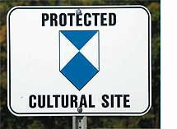
Examples of Laws and Regulations
Cultural property must be respected per
  The 1954 Hague Convention
  United Nation’s Secretary General (UNSG) Bulletin on the Observance by the United Nations Forces of International Humanitarian Law (ST/SGB/1999/13)
  United Nations, Environmental
  Policy for Field Missions, 2009
North Atlantic Treaty Organization
(NATO) documents also address
cultural property protection
This UN symbol means this
property requires protection
Notes:
There are a number of international documents governing the protection of cultural property. Most important is the 1954 Hague Convention. It should be carefully read in its entirety.
Furthermore, the Geneva Convention of 1949 and its additional protocols I and II (1977) affirm that the “protection of cultural property within an operations area is a legal obligation under international law; prohibit use of cultural property for any military purpose that is likely to expose it to destruction or damage, and forbid directly any act of hostility against such property, unless imperative military necessity” so dictates.
In addition, the Secretary-General’s Bulletin on the Observance by United Nations Forces of International Humanitarian Law (ST/SGB/1999/13), paragraph 6.6, states that:
”the United Nations force is prohibited from attacking monuments of art, architecture or history, archaeological sites, works of art, places of worship and museums and libraries which constitute the cultural or spiritual heritage of peoples. In its area of operations, the United Nations force shall not use such cultural property or their immediate surroundings for purposes which might expose them to destruction or damage. Theft, pillage, misappropriation and any act of vandalism directed against cultural property is strictly prohibited.”
Among the NATO documents that should be consulted are: NATO Standardization Agreement (STANAG) 2581, AJEPP-1 Environmental Protection Standards and Norms for Military Compounds in NATO Operations, September 2011; STANAG 7141, ed. 5, Joint NATO Doctrine for Environmental Protection during NATO-led Military Activities, December 2008; and Annex J (”Cultural and Historical Resource Management”) of NATO STANAG 2582, ed. 1, AJEPP-2 Best Environmental Protection Practices for Military Compounds in NATO Operations, September 2011
A distinctive blue and white graphical symbol — designed to be visible from great distances, even from satellite photos — is the only type of marking recognized under international law for protecting cultural property during a period of armed conflict. Use of the Blue Shield is defined in Articles 16 and 17 of The 1954 Hague Convention. This Blue Shield is to cultural property what the Red Cross or Red Crescent is to people. The symbol means: "this requires protection."
For country-by-country information, United Nations Educational Scientific and Cultural Organization (UNESCO) has developed a database of national cultural heritage laws. This database can be accessed through www.cchag.org, under the ”Legal Primer” tab on the top banner.

Slide 6
Environmental Officer (EO) Responsibilities*
Access government intelligence and other information (such as public documents and websites) prior to deployment
Be familiar with and understand applicable laws and policies (e.g., international, your own nation’s, host nation law, mission regulations)
Work with local, international subject matter experts (SMEs) at museums, archeological, religious sites, etc.
Identify cultural and historical sites during base selection and set-up
Create a list of protected cultural property within the base (and area of operations), and keep it updated. Provide this information to the base commander so that troops can be given guidance to try to:
  Avoid adverse effects if possible
  Minimize direct impacts and collateral damage if avoidance is not an option
  Recover: take appropriate responses and reactions when cultural property has been damaged
  Maximize respect for and protection of cultural property, which can result in greater mission success
Document information prior to transfer and/or closure of the base camp
*This assumes there is no cultural affairs officer in the deploying force
Notes:
Assuming there is no cultural affairs officer with the deploying troops, the responsibility for cultural and historical protection will likely fall to the environmental officer (EO). It will be important to do whatever research is possible ideally before deployment, to be aware of what cultural property sites might be in the deployment area. This slide lists a number of the preparatory steps that should be taken to develop this baseline knowledge. The EO should first access intelligence and other information from his military organization and other government entities. This information can be supplemented with publically accessible documents and websites. A good website for cultural training in recent deployment areas (as of 2013, there are sections on Iraq, Afghanistan and Egypt) is at www.cemml.colostate.edu/cultural/cptraining.html.
Subject matter expertise about the region where the base is being set up (and in the area of military operations) may be found at the local and national level in the host country (e.g., museum personnel, academics, cultural departments within the government). There may also be SMEs in your own country or in international organizations such as the United Nations Educational Scientific and Cultural Organization (UNESCO), www.unesco.org. For example, UNESCO has published the World Heritage Atlas and publishes a magazine series, World Heritage Review. A useful general reference source is the CIA World Factbook, https://www.cia.gov/library/publications/the-world-factbook, which is searchable by region and individual countries.
Once the initial baseline of information is available—both for the base and the area of operations—it is important to keep the base commander apprised of any updates to this information to ensure proper guidance is given to all the troops. The main principles for the troops should be to: avoid adverse impacts if possible; minimize damage if complete avoidance is not possible; when property is damaged, take appropriate action; and maximize respect for these resources. (These points are taken from, and more fully defined in, Laurie Rush, “The Cultural Minefield: A Manual on Cultural Property Protection for the Operator Forward,” likely available through www.cchag.org.)
Finally, when either transferring the base to another command or when closing the base, it is important to document all the information: what cultural property resources exist (at the base and in the area), their condition, any actions taken to repair any damage, etc.

Slide 7
Sample Flowchart
You have a ground-disturbing project
Check maps and references. Interview local leaders, academia or citizens. Walk the site.
Determine: Is it archeologically sensitive?
No
Yes
Proceed, but be aware
Yes
Can you plan for avoidance?
No
Inform the EO. Coordinate with Embassy and your
Headquarters (HQ) Environmental Section
Does the archaeology appear to be significant?
No
Yes
Document your findings
EO initiates reach back and coordination
Is there a mitigation plan?
Minimize impacts
No
Yes
Yes
Is the project critical to the mission?
Implement the plan
No
Rethink the project
Notes:
This slide is an example of a decision-making flowchart for addressing potential cultural resources at a base camp. It is adapted from Appendix K of U.S. Central Command (CENTCOM), Regulation 200-2, CENTCOM Contingency Environmental Guidance and Laurie Rush, “The Cultural Minefield: A Manual on Cultural Property Protection for the Operator Forward.”

Slide 8
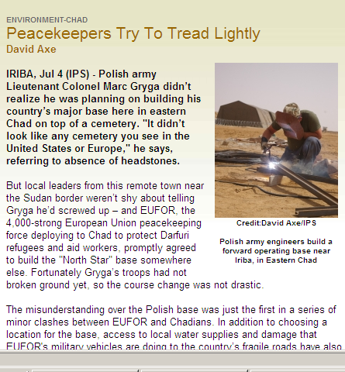
What You SHOULD Do
Recognize that safeguarding cultural property in-theater may be required by treaty and law
Learn about cultural or historical sites and values where you are
Learn about basic geography of the area: not everything may be what it appears (e.g., in some places, what seem like natural hills are actually archeological sites)
Notes:
In learning about the culture, familiarize yourself with different types of cultural sites and monuments in that area. An important source for information of recognized sites is UNESCO. A list of sites is found at http://whc.unesco.org/en/list. A more complete list of “DOs” and “DON’Ts” can be found in Laurie Rush, “The Cultural Minefield: A Manual on Cultural Property Protection for the Operator Forward,” Appendix 2.
The newspaper clipping on this slide explains one case where local leaders protested that the planned location for the military’s peacekeeping camp was, in fact, a cemetery. Fortunately, this information became known before the troops had started to set up the camp and it was agreed that an alternate location had to be found. This case is just one example where the geography and topography may well not be what it seems. In many cases, areas that look like natural hills or mounds are actually of cultural or historical value. They can be archeological sites that could even have ancient cites or fortresses underneath them. The CIA World Factbook is an especially good starting point for learning about the geography of an area. The U.S. Geological Survey website may also provide some initial information, www.usgs.gov, as might National Geographic and UNESCO.

Slide 9
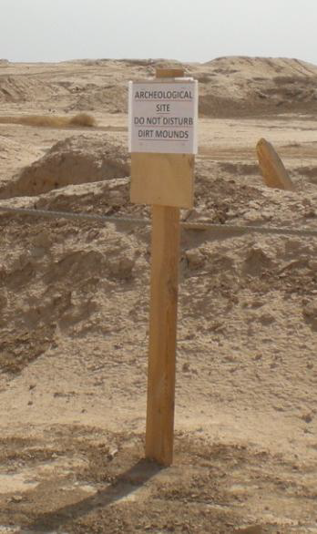
What You SHOULD Do
Ask questions and consult with experts, especially before beginning any construction
If the camp area has cultural sites
  Document site conditions using photos and global positioning system (GPS) to verify
  location and coordinates
  Develop ways to protect the sites
  (e.g., warning signs with appropriate
  UN symbol)
  Report any observed looting
  or vandalism
Posted sign: Archeological site.
Do not disturb dirt mounds
Notes:
When you first enter an area with known cultural assets, ask questions as much as possible. If there are known archeological sites, try to identify the governmental institutions and authorities who are responsible for them. Also, try to find the local Civil Affairs officer who may have information or advice. An internet search using the name of the location and “cultural property” may also yield some leads on available resources. This is the kind of information that should be included in the Environmental Baseline Survey (EBS).
For experts, try to find host nation authorities or reach back to your own country’s subject matter experts or those in international institutions, especially before beginning any kinds of construction.
When posting signs about protected sites, be sure they include the appropriate UN “blue shield” symbol.
If you either see yourself or hear reports of others who are looting or vandalizing sacred or historical sites, report them to the proper authorities.

Slide 10
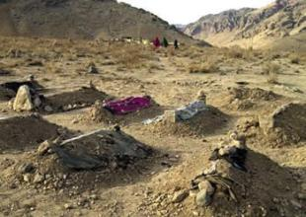
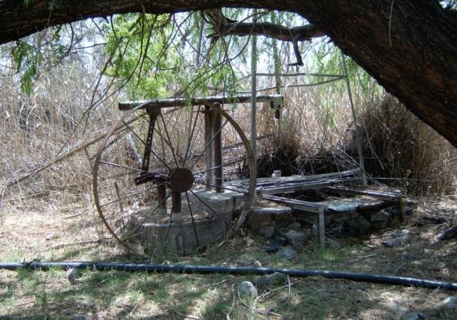
What You Should NOT Do
While recognizing that military requirements take precedence,
Do not bed down without determining if the site is historically important
  Do not assume you can tell this from maps
  Do not assume you know what to look for (valuable objects may not look important)
Do not drive over or across cultural property or historical sites
Do not dig at an archeological site without higher level approval
Do not disturb any artifacts you find on the ground
Above: Afghan cemetery;
below: ancient well
Notes:
These slides offer examples of some of the things you should not do, to the extent allowed by the military operation. The important point here is that things are not always what they appear to be. This is why knowing how culturally valuable sites MIGHT look in a particular area of the world is so important.
The Afghan cemetery picture was taken from U.S. Africa Command (AFRICOM), “Cultural and Historical Resources Management in Peace Support Operations,” presentation to Kofi Annan International Peacekeeping Training Centre, 2012. The ancient well picture was taken from materials prepared under the auspices of the U.S.-South African Environmental Security Working Group, April 2007.

Slide 11
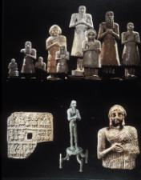
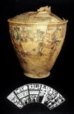
What You Should NOT Do
Without a direct order or imperative military necessity:
  Do not climb on or deface any monument or site
  Do not make unjustified military use of a cultural site
Do not remove or purchase artifacts, antiquities, or cultural heritage items
Notes:
Posters showing pictures such as these can be used to raise awareness among the deploying troops about local antiquities or cultural heritage items. These pictures were taken from U.S. Africa Command (AFRICOM), “Cultural and Historical Resources Management in Peace Support Operations,” presentation to Kofi Annan International Peacekeeping Training Centre, 2012.
You should not use cultural sites for military use. However, if the enemy combatant has done so, military response for the purposes of force protection is justified.

Slide 12
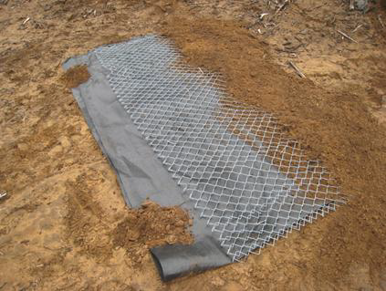
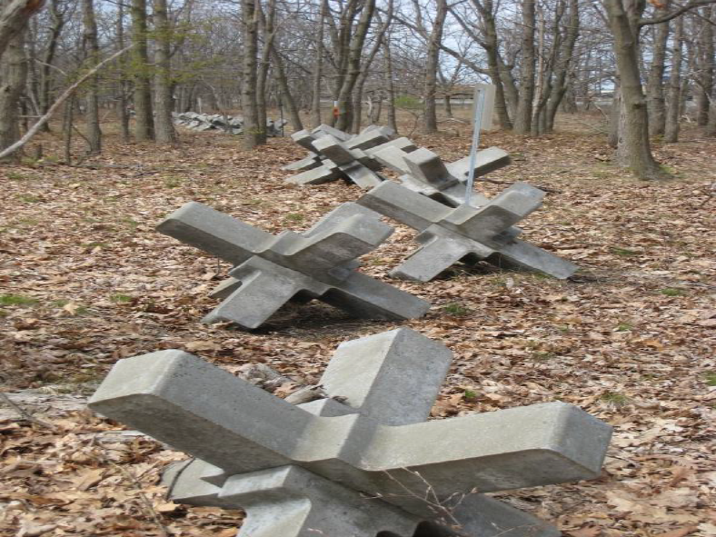
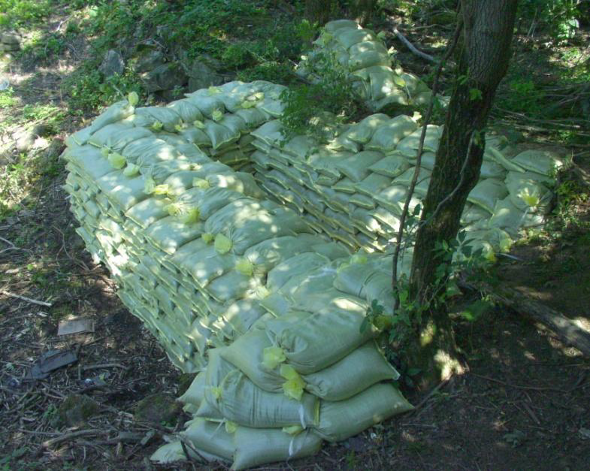
Ways to Protect Cultural Sites
If military needs dictate
the use of a protected cultural
site, these are examples
of bed-down protections
Notes:
These pictures are taken from Laurie Rush, “The Cultural Minefield: A Manual on Cultural Property Protection for the Operator Forward,” Appendix 3. That appendix also contains descriptions of the advantages and disadvantages of these and other protection measures.
From top right to bottom left: fabric and fencing materiel laid over site; barrier to block off cultural site; sandbags covering a gravesite.

Slide 13
Examples of Visual Tools
The next slides show examples of ways to raise awareness among deploying forces about cultural property protection issues. In addition to posters that can be displayed in the base camp, for example, these examples show playing cards created in both The Netherlands and the United States. The third example is a pocket card, developed in the United States, that has been given to deploying forces
Notes:
The U.S. examples are available from James Zeidler and Alexandra Wallace, Product Catalog for Cultural Property Protection Planning and Training in the Department of Defense (Alexandria, VA: DOD Legacy Resource Management Program), Fall 2010, www.cemml.colostate.edu/assets/pdf/Legacy_CPP_catalog. This catalog describes various products that the United States has developed to raise awareness of cultural property protection. This site is a good “first step” for seeing what materials might be relevant. (The catalog is also available through www.denix.osd.mil/cr/upload/09-324-Product-Catalog-for-Cultural-Property-Protection-Planning-and-Training.pdf.)
In addition, the website www.cchag.org has links to the U.S.-created soldier pocket guide and playing cards (for Iraq, Afghanistan and Egypt), under the “products” tab of the home page banner.

Slide 14
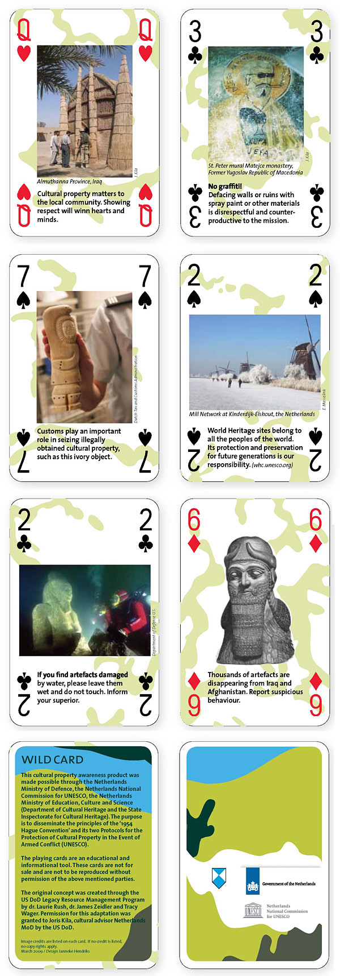
Examples of Playing Cards
Notes:
These are examples of the cultural protection playing cards developed by the Government of The Netherlands, in cooperation with UNESCO, to raise awareness about the 1954 Hague Convention and its two protocols.
Clear images of these cards can be obtained via the following link: http://aiamilitarypanel.org/cultural-property-awareness-playing-cards. The “Wild Card” notes that these cards are not for sale

Slide 15
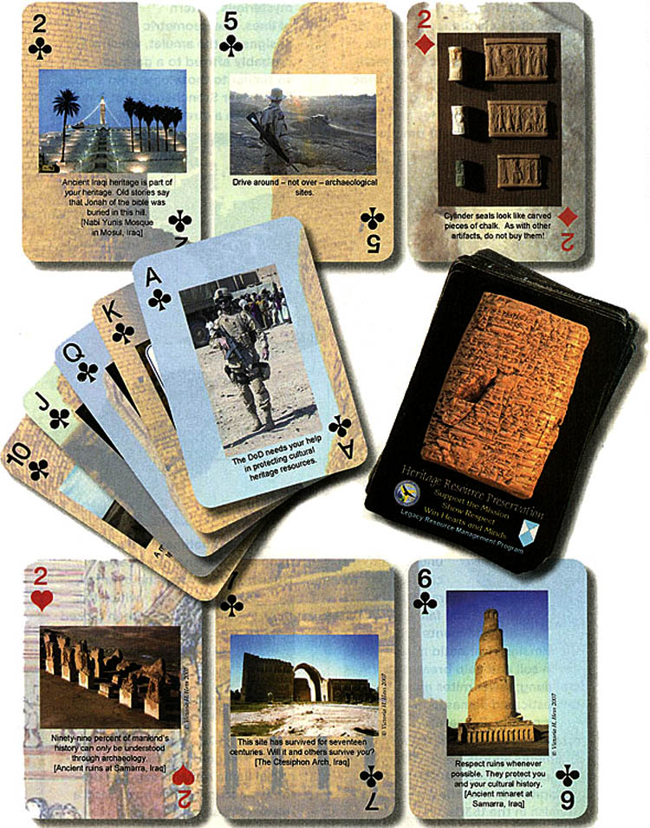
Examples of Playing Cards
Notes:
This sample of playing cards has been downloaded from James Zeidler and Alexandra Wallace, Product Catalog for Cultural Property Protection Planning and Training in the Department of Defense (Alexandria, VA: DOD Legacy Resource Management Program), Fall 2010, www.cemml.colostate.edu/assets/pdf/Legacy_CPP_catalog.

Slide 16
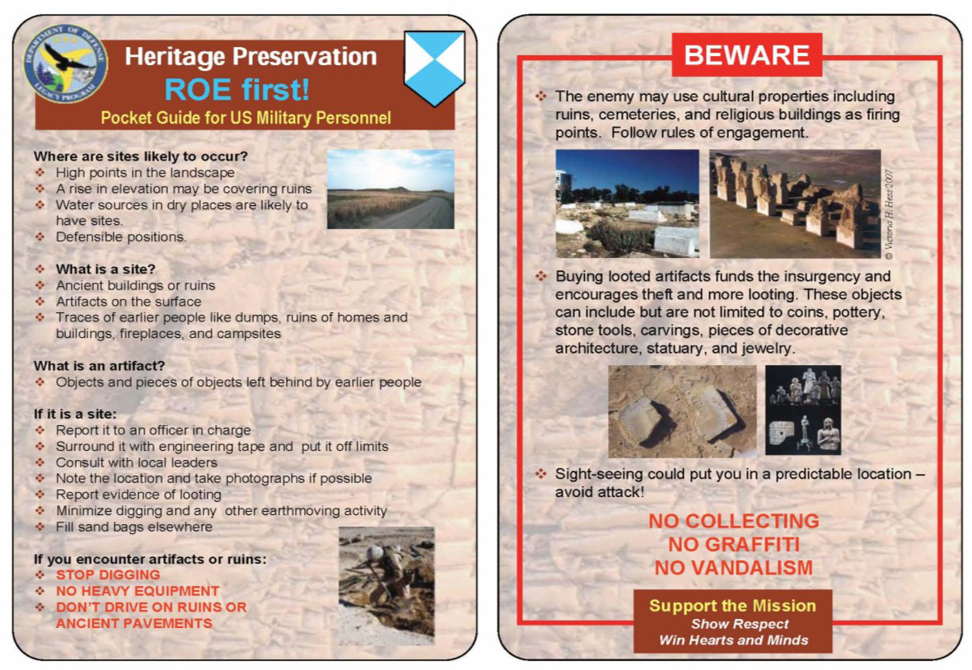
Pocket Card
Notes:
This Soldier Pocket Card is intended for carrying in the shoulder pocket of the Battle Dress Uniform for ready-reference information on cultural heritage issues and cultural property protection. It is available in English, German, Dutch, and Arabic. The card is 6 x 4 inches in size and is printed on pliable and waterproof material.
This card has been downloaded from James Zeidler and Alexandra Wallace, Product Catalog for Cultural Property Protection Planning and Training in the Department of Defense (Alexandria, VA: DOD Legacy Resource Management Program), Fall 2010, www.cemml.colostate.edu/assets/pdf/Legacy_CPP_catalog. There is also a link to this pocket card in the informational aids section of the Reference Module in this toolbox.

Slide 17
Conclusions
Protection of cultural property and historical resources
  Has potential legal implications
  Shows respect for others’ history and culture
  Preserves antiquities and resources that can be of worldwide significance
  Can foster good will from local government and community
Failure to do so can
  Alienate the local population, which can negatively affect the mission

