Slide 1
Munitions
Are
Dangerous
Follow the 3Rs of Explosives Safety
Notes:
Notes:
Explain: The purposes of this presentation is to:
State the 3Rs of Explosives Safety and their meaning.
Learn how to recognize hazards associated with munitions, including unexploded ordnance or UXO, at your installation.
Understand the reason munitions, particularly UXO, are dangerous.
Stress the importance of the 3Rs of Explosives Safety:
Recognize – when you see a munition and that it is dangerous
Retreat – do not touch it, but carefully leave the area
Report – call local authorities to report what you saw
Advise audience they must:
Be aware of the dangers that munitions pose
Know the actions to take to protect themselves, their families, friends and communities

Slide 2
Munitions are designed to be dangerous
Munitions are designed to be dangerous. Our nation’s military have used and continue to use land and water across the United States for live-fire training or testing with munitions. As a result, munitions that are unexploded ordnance (UXO) may be present on both land and in the water. No matter what you call munitions — ammo, explosives, unexploded ordnance or UXO, duds, souvenirs — remember munitions are dangerous and can explode if you touch, move or disturb them.
Munitions may be encountered anywhere past or present military training occurred.
Personnel also have been injured or killed from munitions.
Should you encounter a munition – follow the 3Rs

Slide 3
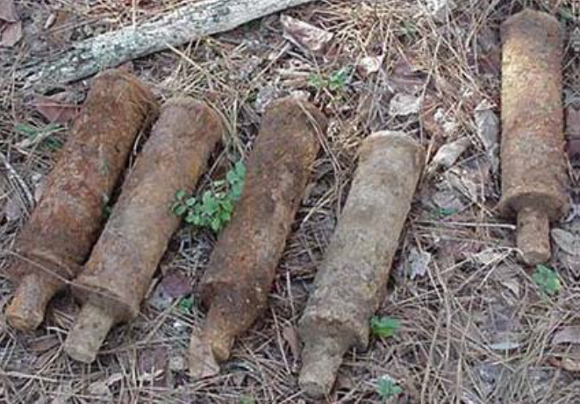
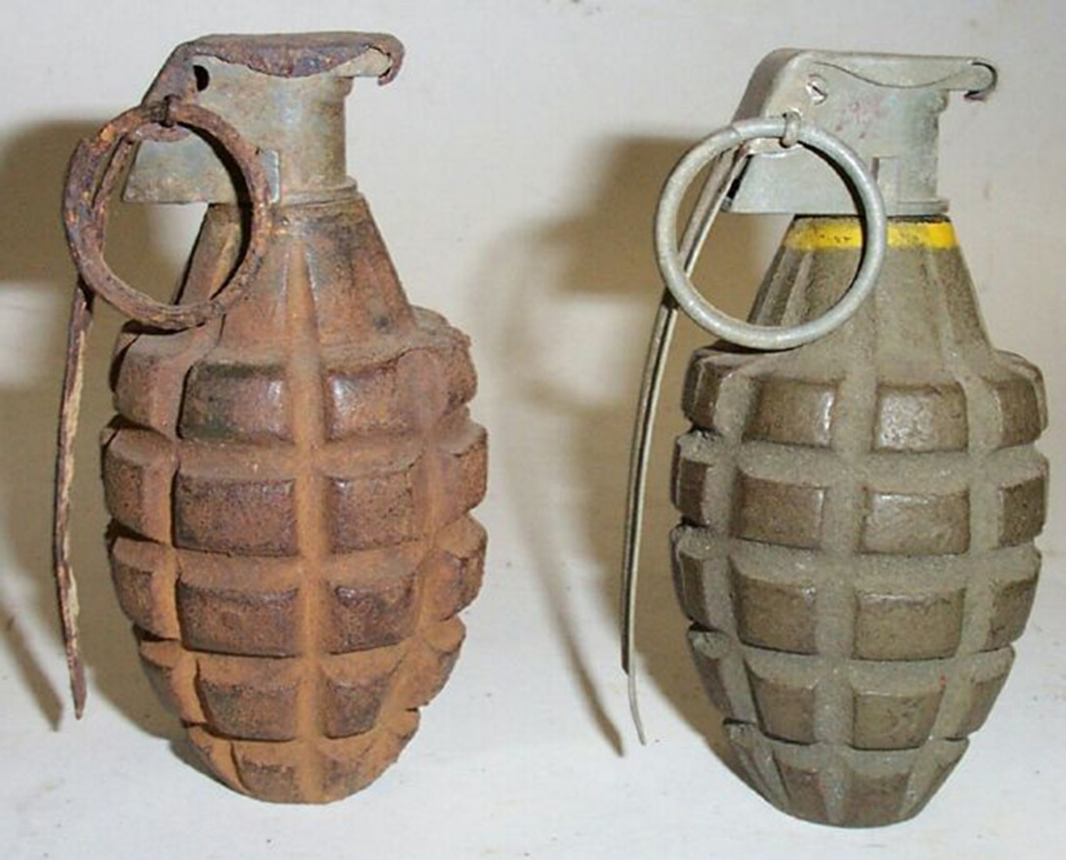
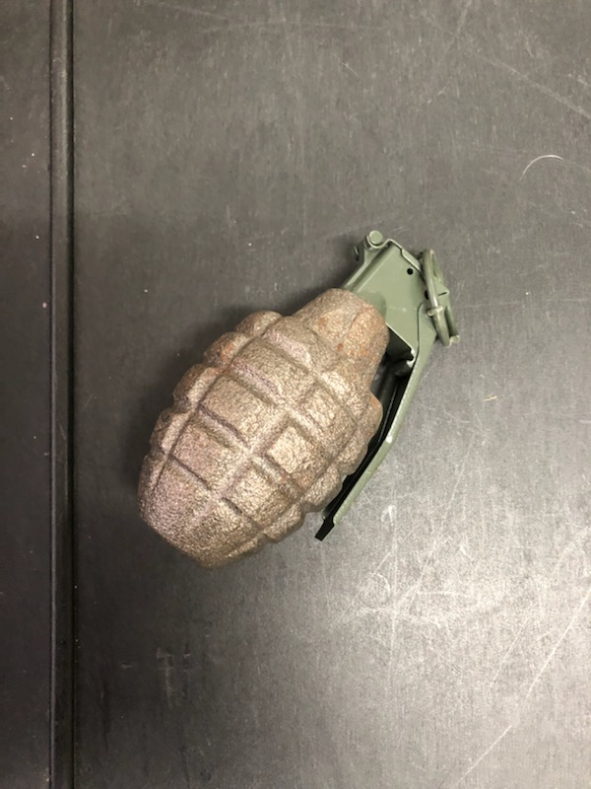
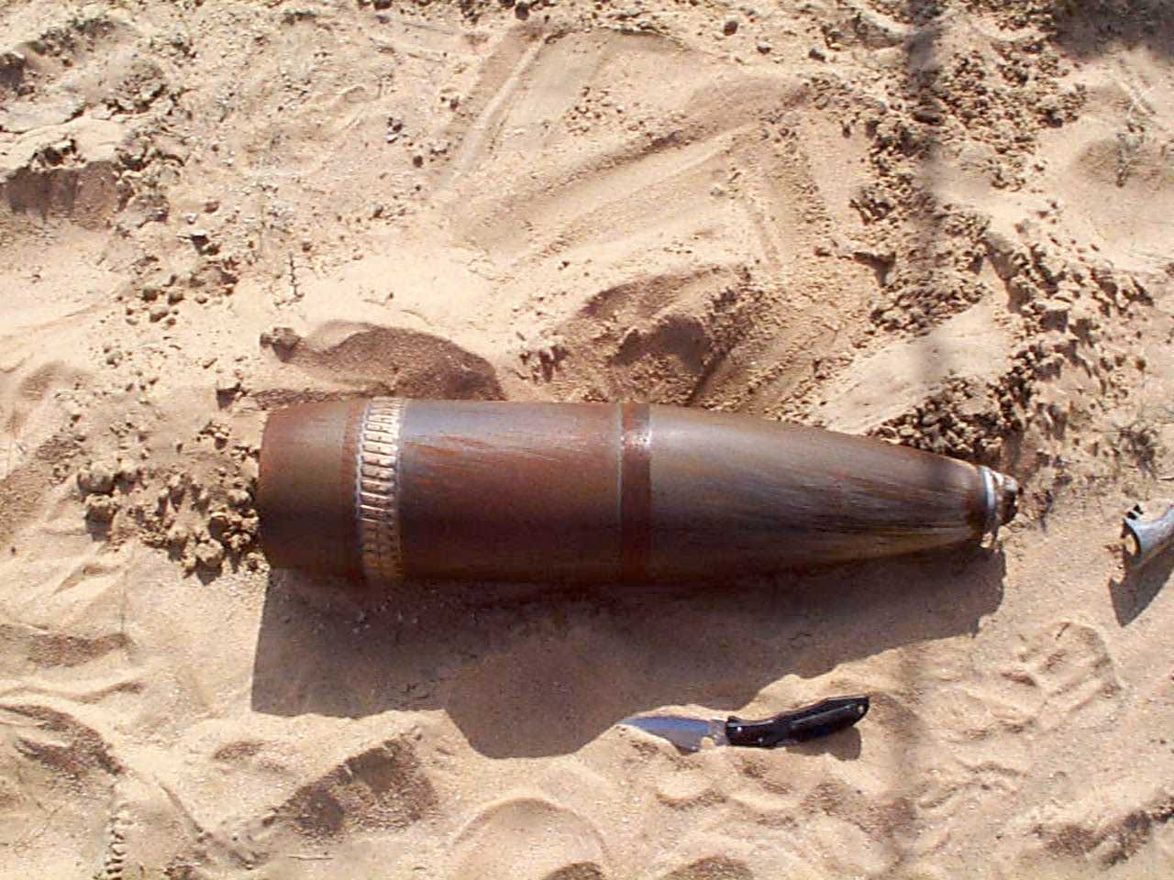
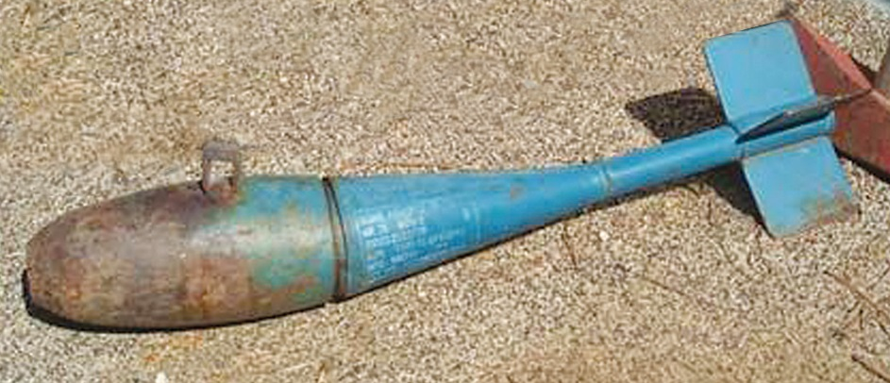
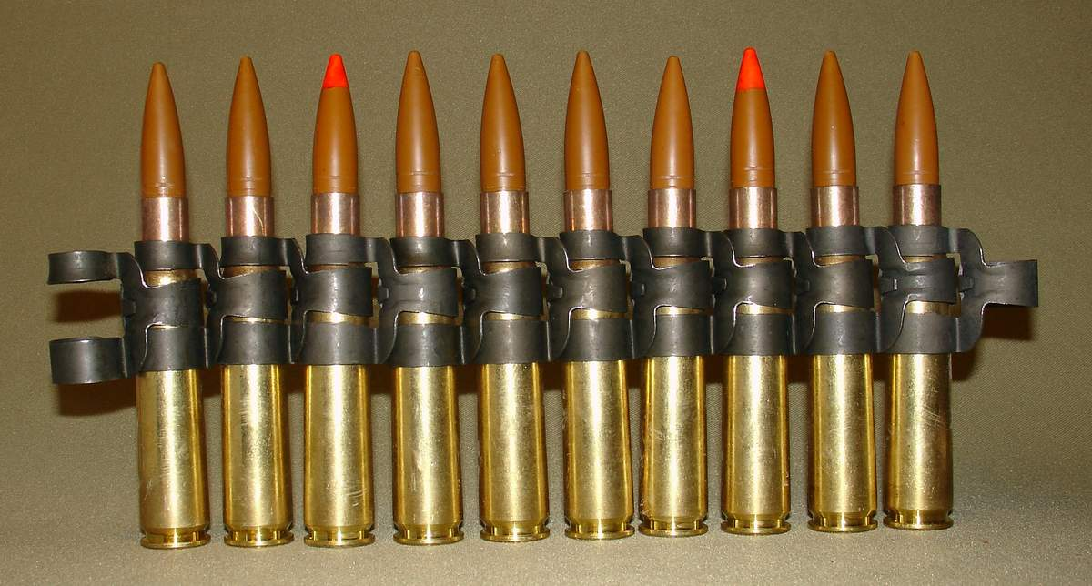
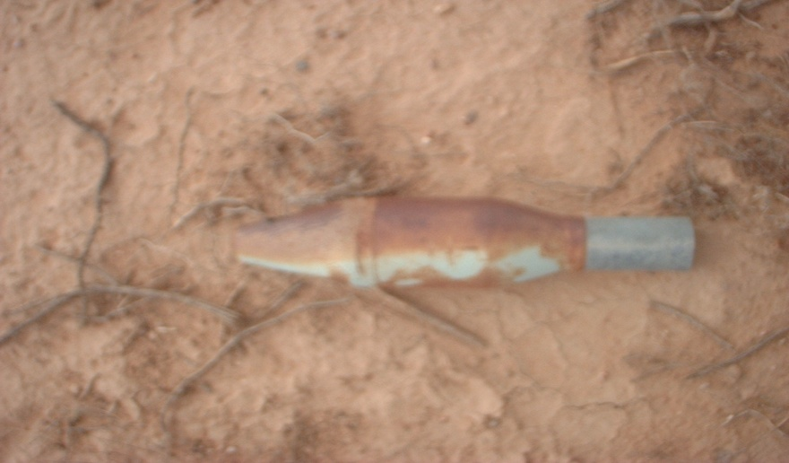
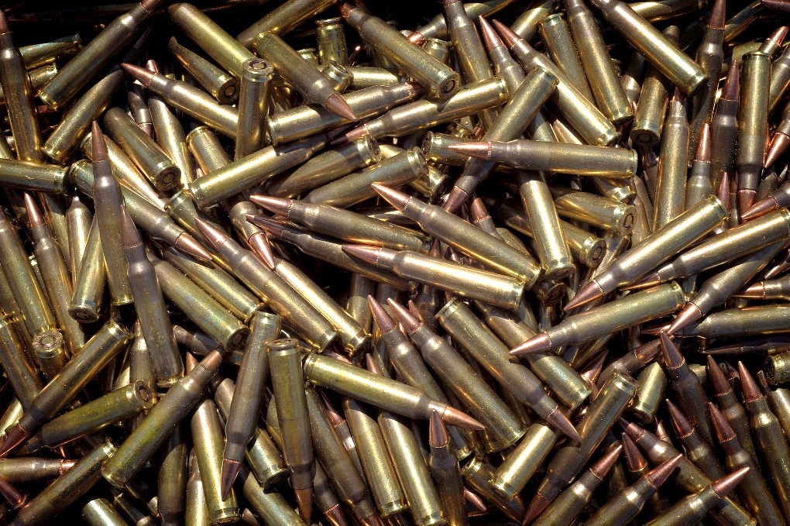
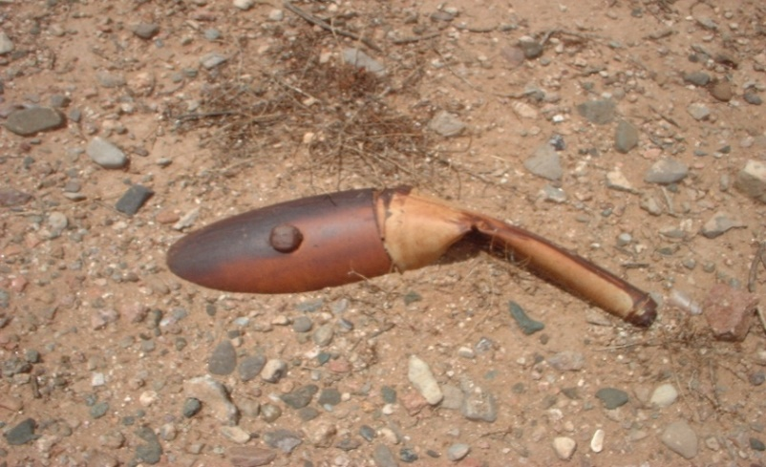
What Are Munitions?
Munitions are military weapons, ammunition or supplies. Examples include:
Grenades
Artillery
& Mortar Rounds
Bombs
Small Arms Ammunition
Notes:
Notes:
Explain:
For the purposes of this presentation, munitions are military weapons, ammunition, or supplies.
The term military munitions is interchangeable with ammunition (ammo), explosives and ordnance.
Most munitions are designed to kill or injure people or damage equipment and buildings. Even practice and training munitions may contain a small propellant or explosive charge that can be dangerous.
Munitions come in many sizes and shapes. They can be:
Small, like the small arms ammunition (.50 caliber and below) used in personal weapons (e.g., pistols, rifles);
Small, medium, or large projectiles that are fired from mortars, tanks, or artillery pieces;
Bombs dropped from aircraft; or
Missiles, rockets, or torpedoes.
Ask: What are some other examples of munitions with which you are familiar?
Answer: Possible answers include grenades, mines, rockets, mortars, RPGs, cannon balls and torpedoes. Discussion of booby traps and pyrotechnics can also be provided here.

Slide 4
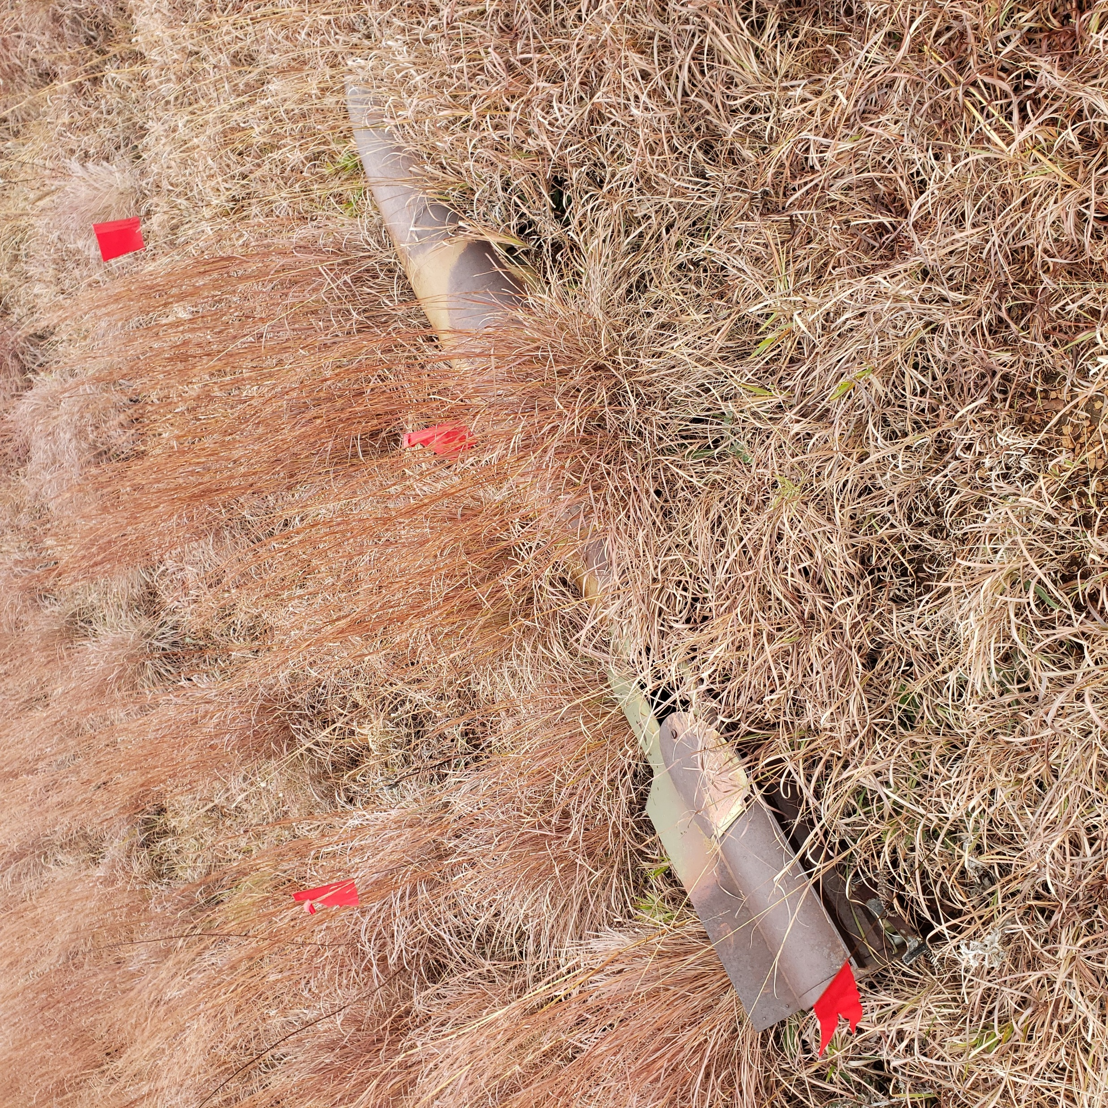
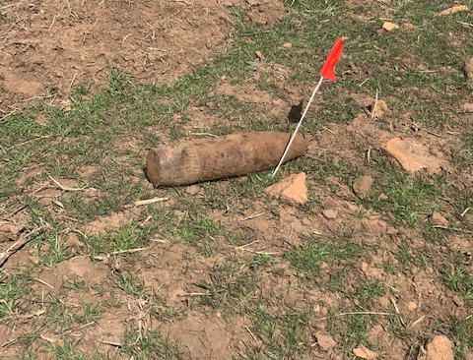
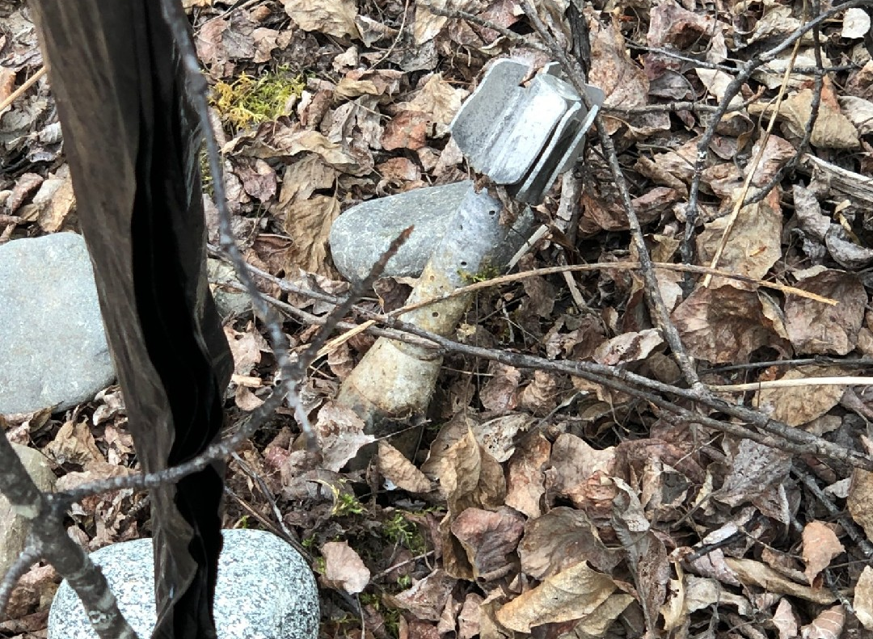
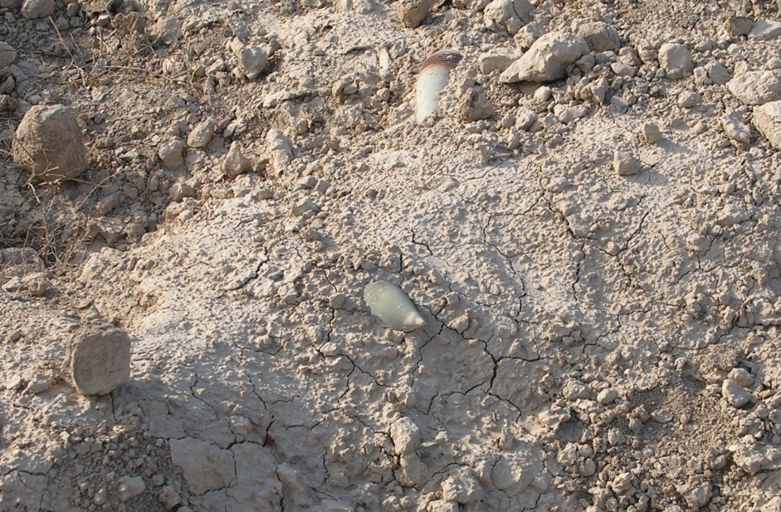
Some Munitions Are Hard To Identify
Photos: Munitions that blend into the environment.
Notes:
Notes:
Ask: Would you recognize the munitions in this photo?
Discuss: These photos show munitions that easily blend into the surrounding environment and make them difficult to spot.
Additional examples of not recognizing munitions:
In 1995, a family on vacation near an active military base found seven unidentified items and took them home. These items turned out to be munitions. Two of these munitions exploded while children were playing with them. As a result, five children were injured and admitted to the hospital. Two were in serious condition, one with head injuries. An Explosive Ordnance Disposal (EOD) Team responded from a local military base and destroyed the munitions. Unfortunately, the family did not recognize the items were munitions and the result was serious injuries.
What you don’t recognize can kill you.

Slide 5
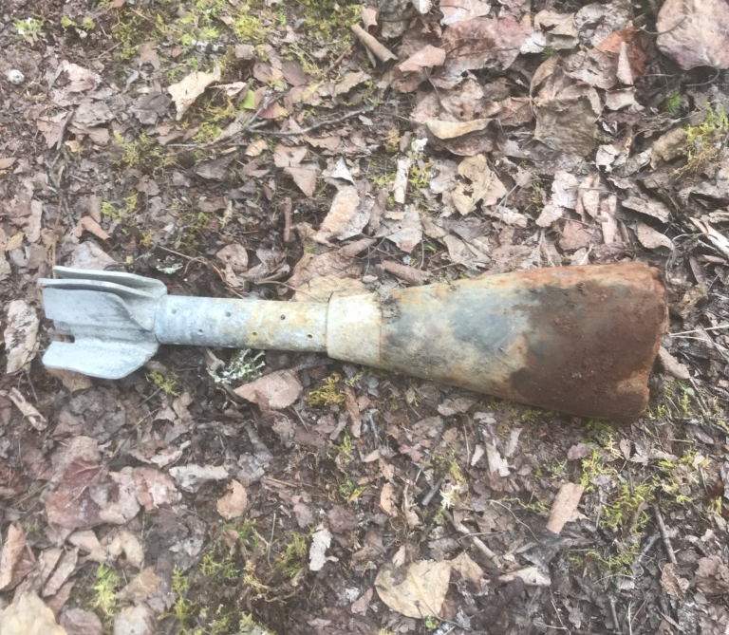
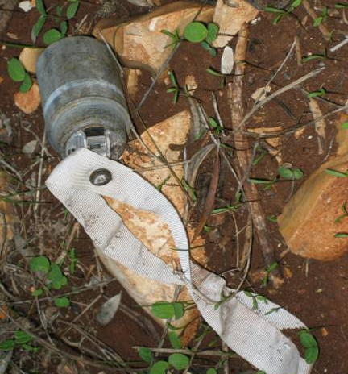
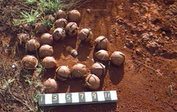
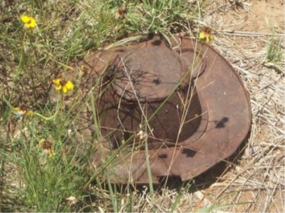
Munitions Vary In Appearance
Munitions are dangerous regardless
of appearance:
Munition type, shape, size, age, or condition doesn’t matter.
Flares, simulators, and blasting
caps are all dangerous.
Souvenir munitions can be dangerous.
Notes:
Notes:
Explain: As you can see from the pictures, munitions vary in appearance. For this reason, you should never pick up anything that you know, or suspect, may be a munition.
Discuss: Munitions, such as those pictured here and throughout the presentation, vary in type, shape, size, age, and condition; consequently, they may be hard to identify as a munitions.
Military munitions:
Come in many shapes, sizes, and types
May not look like a munition (e.g., a projectile, grenade, or bomb)
May be partially or completely buried in the dirt or covered by vegetation, sand, or other material; or partially or fully submerged in water
Use or natural phenomena (e.g., weather, corrosion) can alter a munition’s appearance.
In recent years, munitions have claimed lives. Although such munitions have remained unexploded for decades, aging does not make them safer. If you have a “souvenir” munition in your home or office without the proper tag, identifying it as certified MDAS, please contact your local authorities to safely remove the munition.
Munitions marked with the word “simulator” or “practice” should be considered dangerous because most contain a small explosive charge that can cause serious injuries.

Slide 6

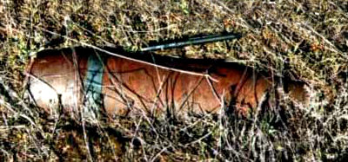
Artillery Projectile
New
Used
Notes:
Notes:
Discuss: This slide provides an example of a munition before and after use.
The picture on the top shows a new, unused 105mm projectile. The picture on the bottom shows a projectile that was fired but failed to function as intended - a UXO.
When a 105mm projectile detonates, metal fragments from the projectile body travel at high speeds to distances up to 1,939 feet - the length of 6½ football fields! Anyone within this area could be severely injured or killed.

Slide 7

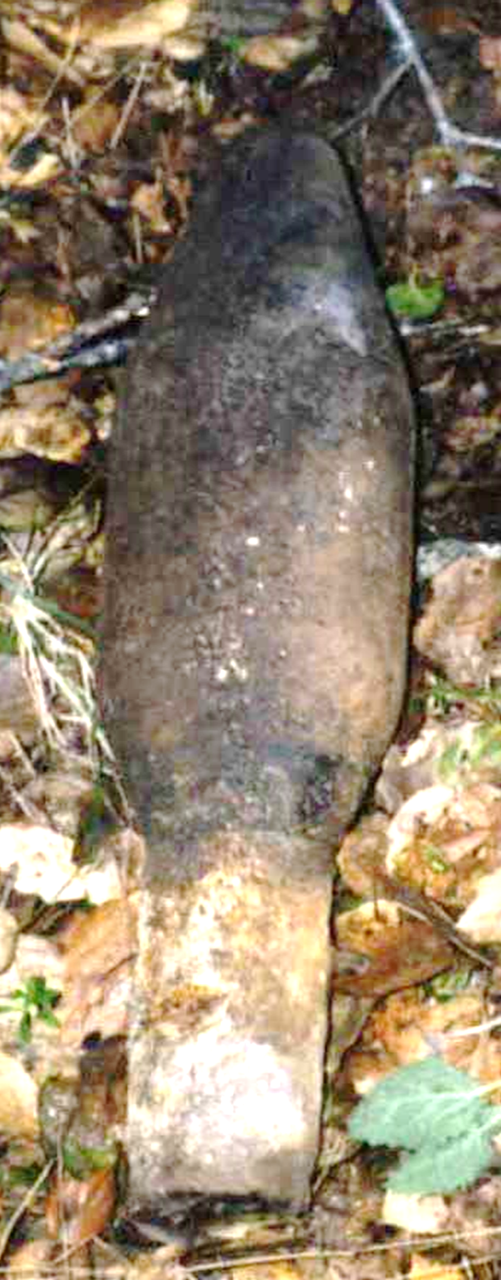
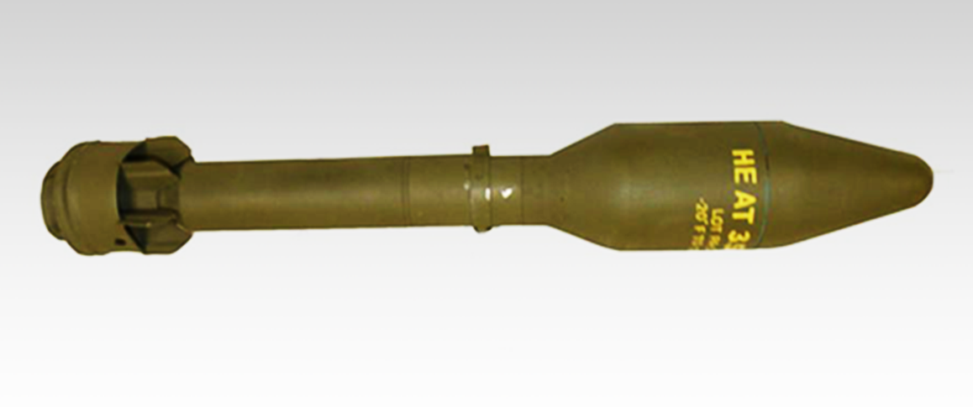
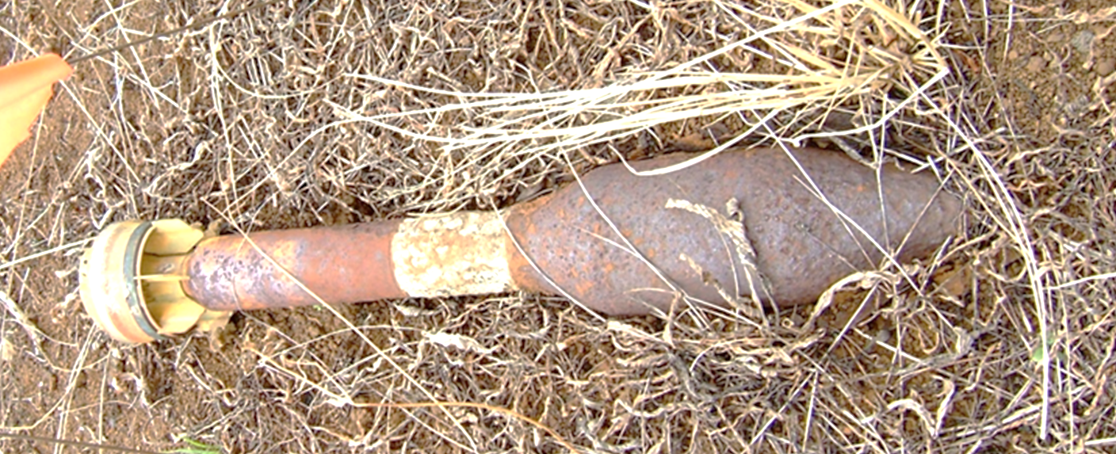
Rockets
Used
Notes:
Notes:
Discuss: This slide provides another example of a munition before and after use. The picture on the top shows a new rocket. The other two pictures show a rocket after use.
Upon detonation either on use or if disturbed as a UXO, people need to be 1,420 feet (almost 5 football fields) away to be safe from the blast and fragments! Anyone closer could be killed or severely injured.

Slide 8
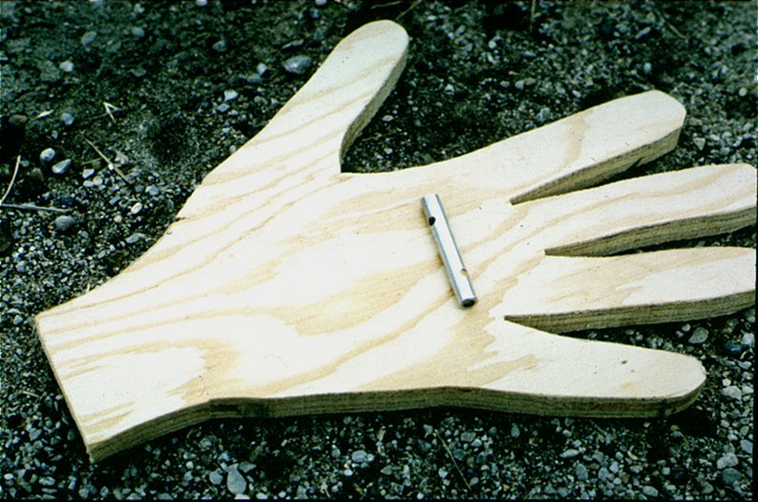
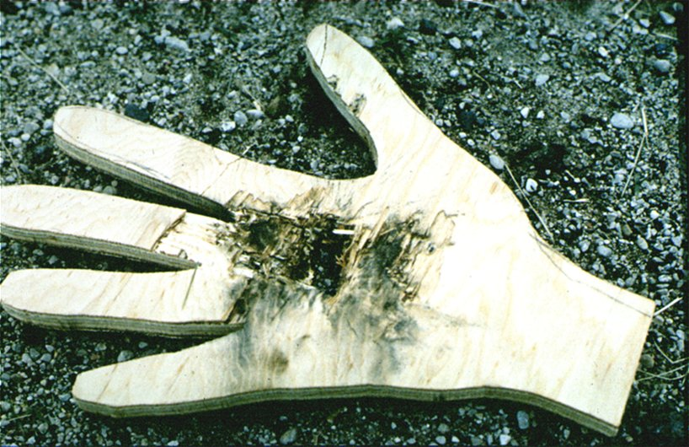
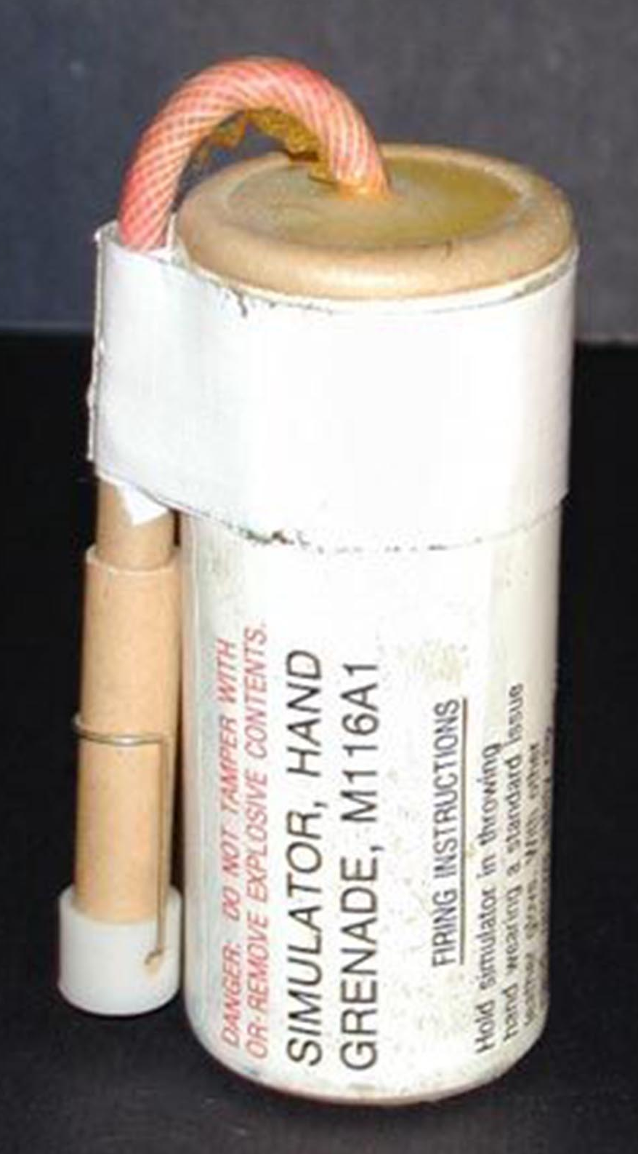
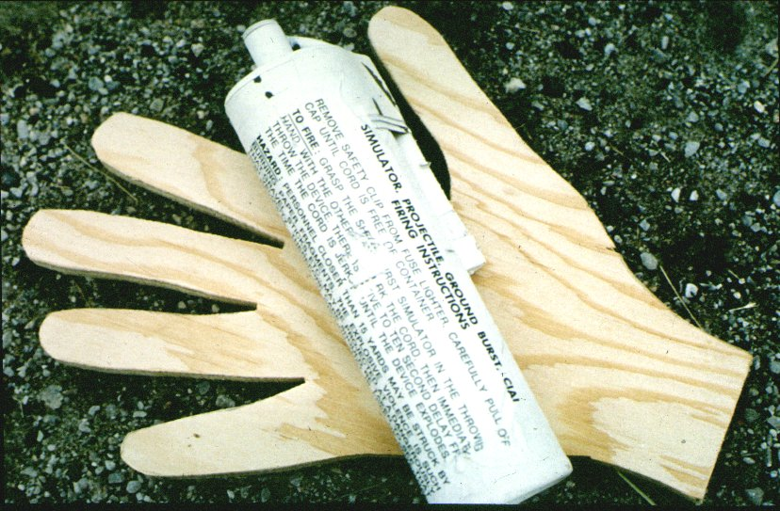
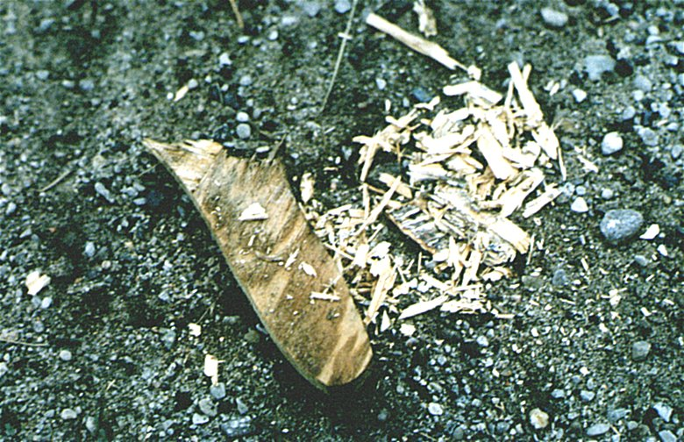
Simulators and practice munitions used for training contain explosive charges that can cause serious injuries.
Simulators and Practice Munitions
Notes:
Notes:
Explain: Munitions marked with the word “simulator” or “practice” should be considered dangerous because most contain a small explosive charge that can cause serious injuries.
These photos show what two different types of munitions can do if they explode in person’s hand. If asked, the top photos show a blasting cap, and you can see it has torn through several layers of wood. The bottom photos show the destruction an artillery simulator can do.
Clearly, tiny explosive devices and simulators, can cause severe injuries or be deadly.
Remember munitions, particularly UXO, do not always look like a bullet or a bomb.
Example of incidents dealing with simulators:
On September 5, 2012, a maintenance staff member found a hand grenade simulator inside Fort Irwin Middle School. The military police, fire department, and EOD were called in to remove the device from campus. The next day another hand grenade simulator was found in a different location in the school. Again, the military police, fire department, and EOD were called in. Bomb-sniffing dogs were also called in to look for additional devices and search classrooms and students’ backpacks. An assembly was held to talk to the 7th and 8th grade students about hand grenade safety. Even though the hand grenade simulators are designed for training, they are still explosives (equivalent to two cherry bombs) and could blow a person’s hand off. Eventually, it was determined that the simulators had been brought back from training by a soldier and his child had discovered them in the garage.
In 1963 at Fort Benning a Sergeant put M-80 Firecrackers (highly explosive simulators used in training) in his field jacket during exercises and ended up taking them home and placing them in a cigar box. Months later his wife gave one to a 13-year-old boy who took it home, lit it, and was taking it outside when it detonated in his hands, resulting in serious injuries to both hands.
Discussion point for handout: In 1983, some boys encountered a munition in a canyon near their home in California. The munition detonated when a boy hit it against a rock. The detonation killed two boys and injured another. After this incident, the military swept hundreds of acres, recovering about 200 munitions. Several years later, a 15-year-old reported to his mother that while riding dirt bikes in a nearby canyon he saw what appeared to be a munition. She immediately recognized the danger and reported the munition to fire officials. Fire officials said the 76mm anti-personnel shell might have exploded had there been a brush fire.
Hand out: 3Rs Safety Guide – Military Families
Play: 3Rs Video – Soldiers – Do You Feel Lucky (31 seconds)
https://www.youtube.com/watch?v=e4XKCSBhBzU&list=PLeSiLkpEC_PSxhu8tTv5IF0vnV4qhOjNA&index=16

Slide 9
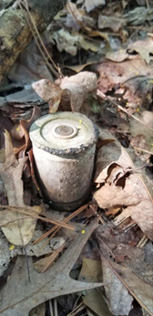
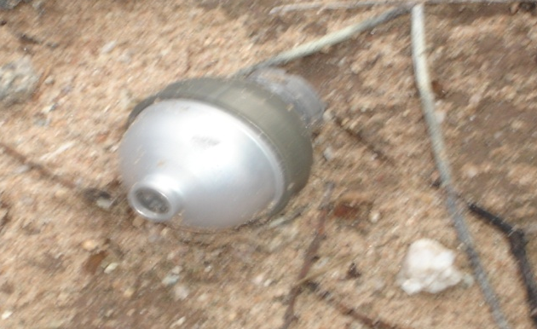
What Is UXO?
What is Unexploded Ordnance?
As defined in 10 U.S.C. 101(e)(5)(A) through (C), the term “unexploded ordnance” means military munitions that:
(A) Have been primed, fused, armed, or otherwise prepared for action;
(B) Have been fired, dropped, launched, projected, or placed in such a manner as to constitute a hazard to operations, installations, personnel, or material; and
(C) Remain unexploded, whether by malfunction, design, or any other cause.
Notes:
Notes:
Explain: UXO stands for Unexploded Ordnance. What is unexploded ordnance?
As defined in 10 U.S.C. 101(e)(5)(A) through (C), the term “unexploded ordnance” means military munitions that:
Have been primed, fused, armed, or otherwise prepared for action;
Have been fired, dropped, launched, projected, or placed in such a manner as to constitute a hazard to operations, installations, personnel, or material; and
Remain unexploded, whether by malfunction, design, or any other cause.
Discuss: 3Rs Fact Sheet – UXO Safety
Play: 3Rs Video – Learn the 3Rs of UXO (3:31 minutes) https://www.youtube.com/watch?v=bJKmlNzglHc&list=PLeSiLkpEC_PSxhu8tTv5IF0vnV4qhOjNA&index=2
or 3Rs Video – USACE – Message A (1:01 minutes)
https://www.youtube.com/watch?v=WnJkIXhfIo&list=PLeSiLkpEC_PSxhu8tTv5IF0vnV4qhOjNA&index=7
or 3Rs Video – USACE – Message B (Beach) (1:01 minutes) https://www.youtube.com/watch?v=x4vvGR8DIM&list=PLeSiLkpEC_PSxhu8tTv5IF0vnV4qhOjNA&index=10

Slide 10
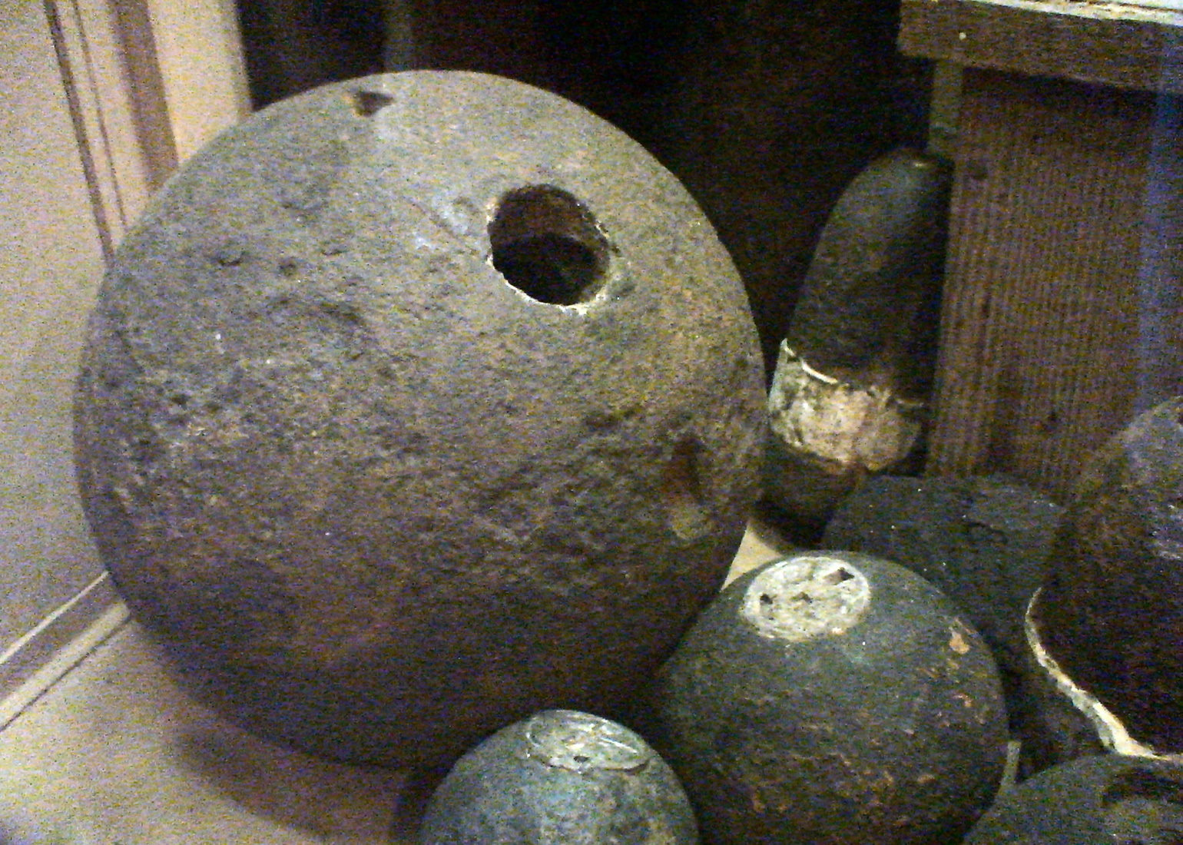
Souvenir Munitions
Souvenir, UXO, Dud, Training Round, War Trophy...No matter what you call them, they can be deadly!
Notes:
Notes:
Explain: Taking or collecting munitions as souvenirs poses real dangers to you, your family, and the public. Souvenir munitions, even Civil War cannon balls that may have been kept by a family and handled for years, can be deadly. If you have taken or collected munitions as souvenirs, keepsakes, or war trophies, call local law enforcement to request EOD support or turn them in under the amnesty program (e.g., place them in an amnesty box). Also note that buying souvenir munitions online does not guarantee they are safe.
Discuss:
In 2006, an adult, who had kept a munition as a souvenir for over 15 years and “thought it was harmless,” allowed neighborhood children to play with it. The children threw it up in the air and when it struck a table, it detonated killing two children and injuring six more. Even though handled many times and kept for years without incident, the munition still proved lethal. Failure to recognize the danger posed by keeping a munition as a souvenir was a heartbreaking error.
Another tragic example of the dangers associated with taking or collecting munitions as souvenirs occurred in 2001. A 9-year-old boy lost his forearm when he dropped a munition that he collected in 1999 at a former artillery range in Tennessee. Unfortunately, his parents, who were aware he had it, did not recognize the potential hazard posed, and their son’s life was changed forever.
Play: 3Rs Video – Soldiers – Souvenir 1 (32 seconds) https://www.youtube.com/watch?v=7femBSk997A&list=PLeSiLkpEC_PSxhu8tTv5IF0vnV4qhOjNA&index=4
or
3Rs Video – Soldiers – Souvenir 2 (31 seconds) https://www.youtube.com/watch?v=ean2jnvAAIs
or
3Rs Video – Soldiers UXO (30 seconds) https://www.youtube.com/watch?v=-vpt-r9OIsY

Slide 11
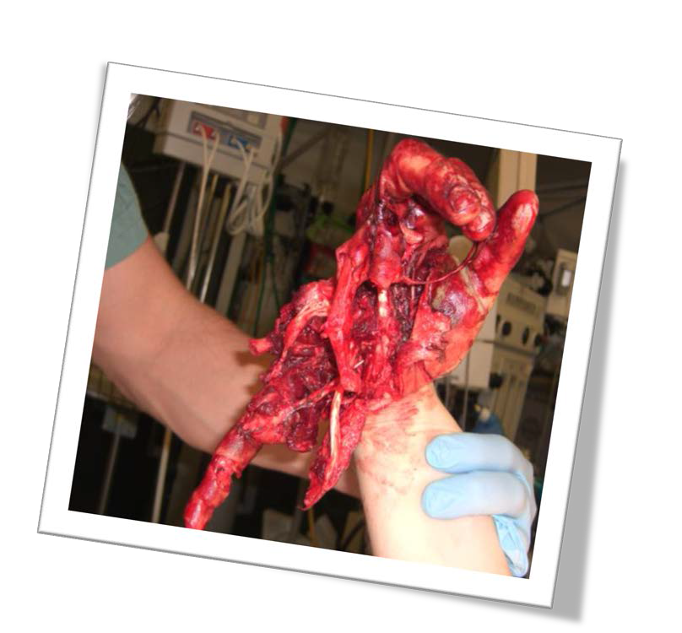

The DANGER Is Real!
Munitions are dangerous. Personnel have been injured or killed from munitions at installations.​
Notes:
Notes:
EOD respond to reports of UXO multiple times per year. EOD personnel identify munitions found around the installation and remove them if necessary.
​
The image on the slide shows the result of a soldier hammering a pin into an artillery piece with a .50 caliber round. The round went off in his hand.
Additional Examples:
In January 2015, two women (part of a small group believed to be looking for scrap metal) on McGregor Range in New Mexico were seriously injured when they came across UXO. The women failed to recognize the danger posed and picked up the UXO which then detonated, leaving the women in critical condition. County Sheriff's deputies, who were first on the scene, discovered additional possible explosives. The FBI’s Explosive, Ordnance and Demolition team investigated the site. Had the women recognized the danger posed by the munitions and then retreated from the area, their lives might be much different. ​
Feel free to add examples from your installation to stress the importance of safety.

Slide 12
Munitions Encounter Areas
Munitions may be encountered anywhere past or present military training occurred. Current range boundaries do not necessarily reflect where munitions may be found.
Notes:
Notes:
Suggest adding a map of installation boundaries to this slide and stressing that munitions may be encountered on or around the installation.
Discuss: Current and past installation boundaries. Emphasize munitions can be anywhere on current and past installation property, not just the operational ranges of the the installation.
Munitions can be encountered anywhere. Although military munitions will most likely be encountered in areas the military currently uses such as operational ranges, tactical areas, and area of operations, they may also be encountered in areas once used for live-fire training or testing, or that were once the site of tactical operations. This may include former training areas that have since been converted to recreational areas or even developments for industrial or residential purposes. For this reason, it is important to know your surroundings and understand if you are in an area that may have a higher chance to encounter munitions. It is also critical to heed any posted warning signs.
An ongoing concern at many installations is scrappers that enter training ranges without authorization and attempt to locate materials for salvage. UXO can enter the recycling stream when it is improperly disposed of or when salvagers illegally collect items from training ranges and sell them to scrap yards. Similarly, souvenir munitions are of particular concern at and around installations. If soldiers or veterans collect souvenir munitions or bring munitions back from training, they may be found in homes or garages.

Slide 13
What Helps Prevent Munitions Incidents
Controlled authorized access to ensure the safety of personnel who have a need to enter an operational range or impact area.
Conduct periodic security patrols to enforce access controls in place at ranges and impact areas and to keep unauthorized people out.
Posted warning signs around munitions areas.
Provide explosive safety awareness briefs to units, contractors, and visitors.
Monitor the appropriate amount of explosives used in training.
Notes:
Notes:
Explain: Provide any details on your installation practices for this slide.

Slide 14
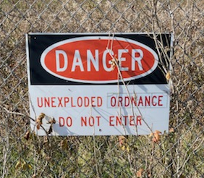
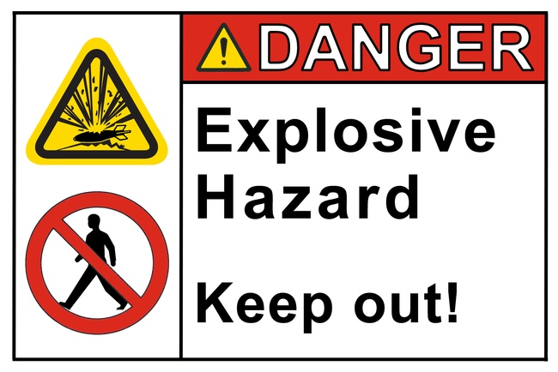
Examples Of Warning Signs
Trespassing in areas with warning signs that say “Do Not Enter” or “Keep Out”:
is hazardous and prohibited by law.
may result in substantial fines.
may result in injury or death.
Notes:
Notes:
Explain: Specific information about your installation’s signage for slide.

Slide 15

  when you may have encountered a munition and that munitions are dangerous.
  Munitions are dangerous and may:
  not look like a bullet or bomb.
  be shiny or rusty.
  be clean or dirty.
  look harmless, but they are dangerous.
  Regardless of whether a munition has been moved, it may still explode.
Follow the 3Rs: Recognize
Notes:
Notes:
Explain: What do you do if you encounter a munition? Follow the 3Rs of Explosives Safety:
Stress:
Recognize - when you see a munition and that it is dangerous
Retreat - do not touch it, but carefully leave the area
Report – call local authorities to report what you saw
The first step is to Recognize that munitions are dangerous. If it looks like a bullet or bomb, treat it like it is one. Leave it alone! Recognize the potential danger!
But keep in mind that munitions may not be easy to recognize. They may not look like a bullet or bomb. They may be shiny or rusty, clean or dirty. They may look harmless, but they are dangerous and even small explosive devices, including simulators, can cause severe injuries or be deadly.
Discuss: The possible conditions a munition may be found in and the hazards with both new and used munitions.

Slide 16

Follow the 3Rs: Retreat
  Do not approach, touch, move, or disturb it, but carefully leave the area the same way you entered.
  In remote surroundings, mark the general area where you encountered a munition, so local authorities can locate it. DO NOT go closer to a munition when marking the area.
Notes:
Notes:
Discuss: The second step is to Retreat - Do not approach, touch, move, or disturb a munition or suspect munition. Carefully leaving the area the same way in which you entered may prevent disturbing it or other items that might be in the area. If possible, as you leave the area, mark it in some manner so that it can be found more easily later.

Slide 17

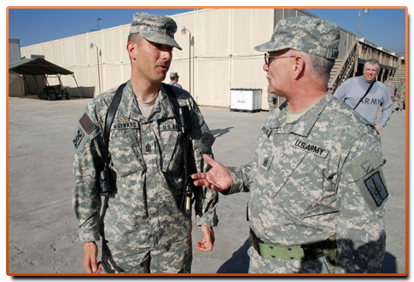
Follow the 3Rs: Report
Call
authorities
  Call local authorities to report what you saw and where
Notes:
Notes:
Explain: The last step is to Report. Describe what you saw and where you saw it. Trained Explosive Ordnance Disposal or EOD personnel will dispose of the item.
Add installation-specific telephone number(s) for reporting UXO to this slide. Note that there may be more than one number for reporting based on the location (i.e. cantonment area, range, or surrounding community).

Slide 18

Additional Resources
https://3Rs.mil
General Educational Resource Materials (Posters, Safety Guides, Fact Sheets)
Self-Guided 3Rs Training
Gallery of Photos
UXO Incidents
Information for Kids & Families, Military & Their Families, Communities, and Workers
Safety Clubhouse Games for Kids
3Rs Videos
Notes:
Notes:
Explain: If you would like additional information or resources for the Army’s 3Rs Program go to https://3Rs.mil. This website is an excellent resource for downloading presentations, videos, photos, handouts, and other resources.
Ask: Does anyone have any questions?
Demonstrate: https://3Rs.mil website

Slide 19



In Summary
Recognize - when you may have encountered a munition and that munitions are dangerous.
Retreat – do not approach, touch, move or disturb it, but carefully leave the area.
Report – Call local authorities
Notes:
Notes:
Review:
Munitions come in many shapes and sizes.
Munitions are designed to kill or injure people or destroy or damage equipment.
Exposure to the environment may change a munition’s appearance.
Do not assume a munition is safe, regardless of the age.
If you or someone else encounters something that might be a munition, follow the 3Rs (Recognize, Retreat, Report) of Explosives Safety.
To help protect yourself, your family and your friends, share the 3Rs message and what you learned with your family and your friends.
Provide: A thank you and closing appropriate to your audience and setting.

