Slide 1

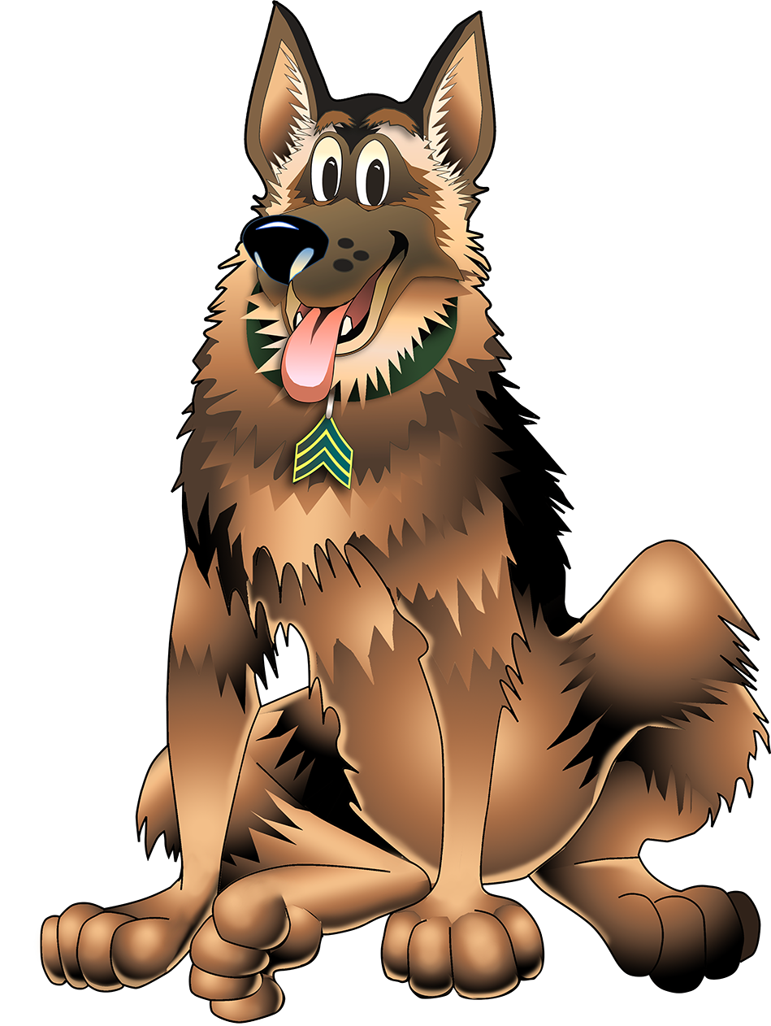
Follow the 3Rs of Explosives Safety
Notes:
Notes:
Explain: This is SGT Woof. He is an ammo safety expert. His job is to teach you to follow the 3Rs of Explosives Safety when you may have seen ammo.
The 3Rs of Explosives Safety are:
Recognize
Retreat
Report
Say them after me…
Recognize…(Recognize)
Retreat…(Retreat)
Report…(Report).
Recognize - when you may have seen ammo and that ammo is dangerous
Retreat – do not get near, touch, move, or disturb ammo; carefully leave the area – do not run
Report – tell your parents or a teacher what you saw and have them call the police
I’m going to read you a story about SGT Woof and his friends that will tell you how to stay safe by following the 3Rs of Explosives Safety.

Slide 2

Sergeant Woof
Hi! I’m Sergeant Woof and I’m an expert in ammo safety.
I’m going to teach you about the 3Rs of Explosives Safety.
Notes:
Notes:
Explain: This is Sergeant Woof. He is an ammo safety expert. His job is to teach you to recognize when you may have seen ammo and that ammo is dangerous. He will also be talking about how to keep yourself, your family, your friends, and your community safe when you see ammo.
Ask: Does anyone know what ammo is?
Answer: Ammo is short for ammunition. Soldiers use ammunition during training and to protect the United States. There are many types of ammo including bullets, rockets, bombs, and grenades. Ammo is designed to kill or injure people or destroy buildings and equipment. Some of you may know people who were in the military or hunt with ammo.
You should be aware that the ammo your parents, brothers or sisters may use for target practice or when hunting can be dangerous if not handled correctly. But we will not be talking about that kind of ammo today.

Slide 3
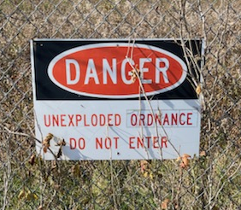
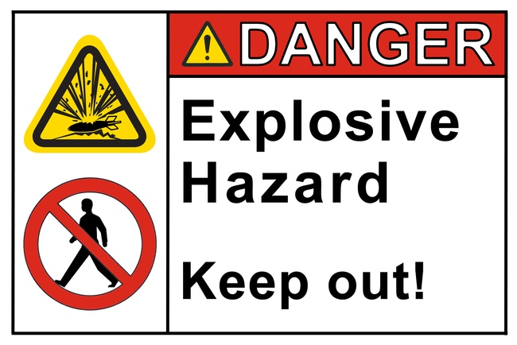
Sergeant Woof Listens to Danger Signs
Obey the signs. Don’t go in areas with warning signs!
Notes:
Notes:
Explain: One day SGT Woof was walking and saw a sign that said “Danger.” He turned around and didn’t walk any closer to the sign. He knew that these signs were posted to help keep people safe. So, he walked in a different direction.

Slide 4
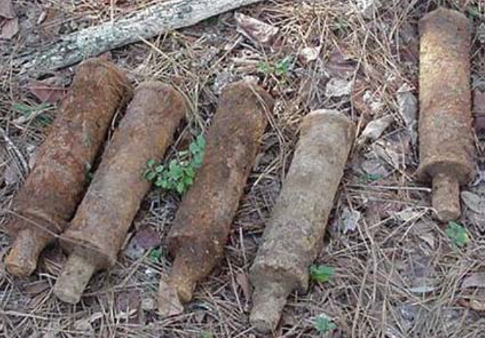
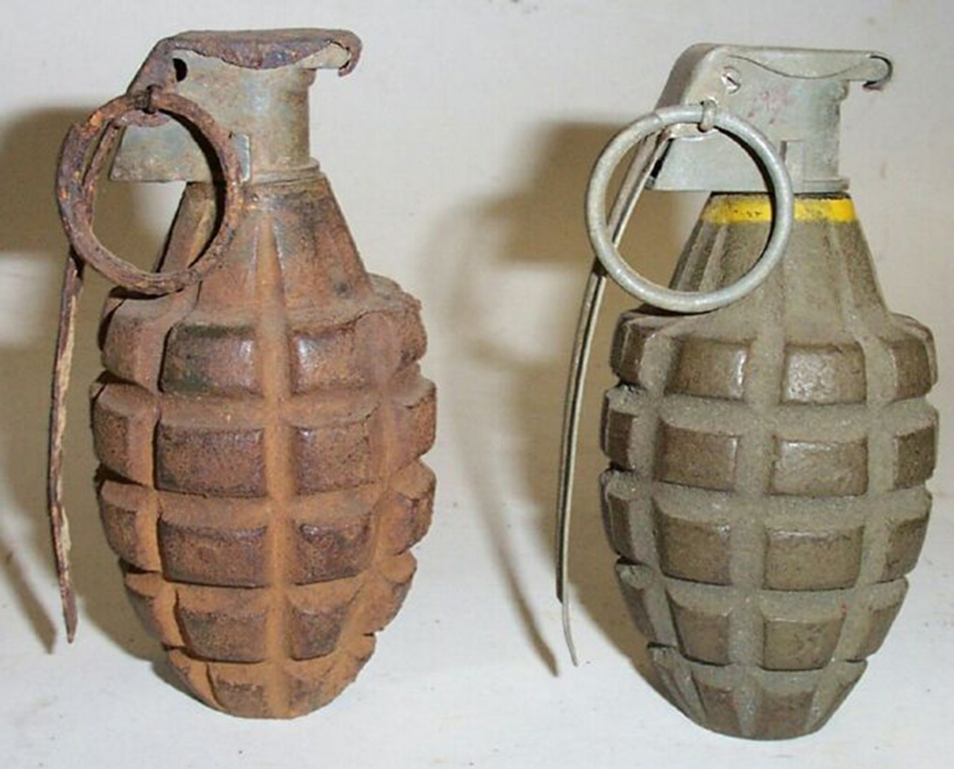
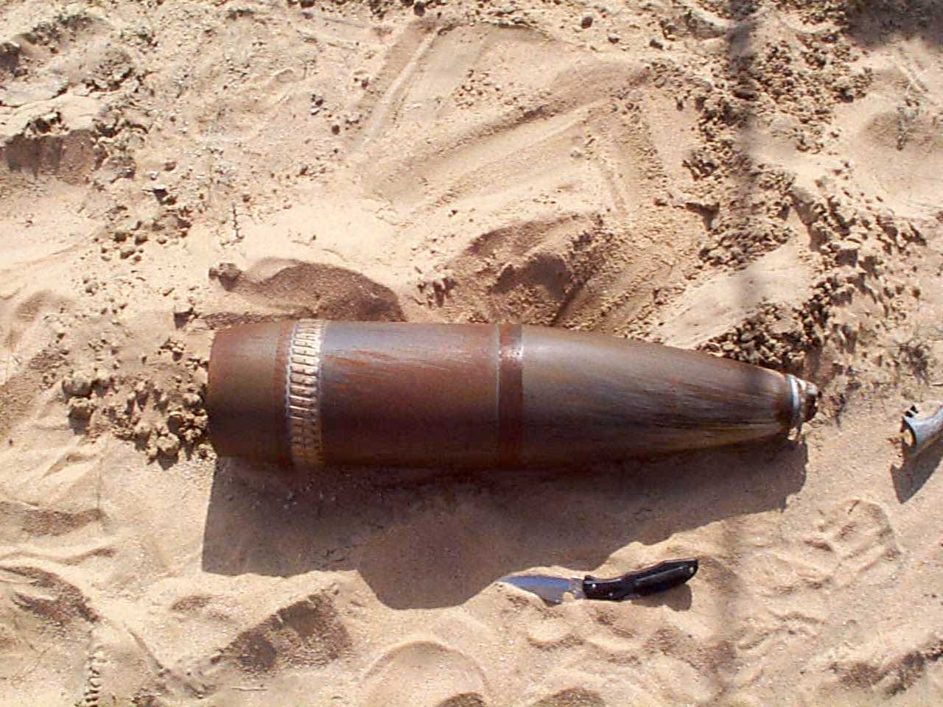
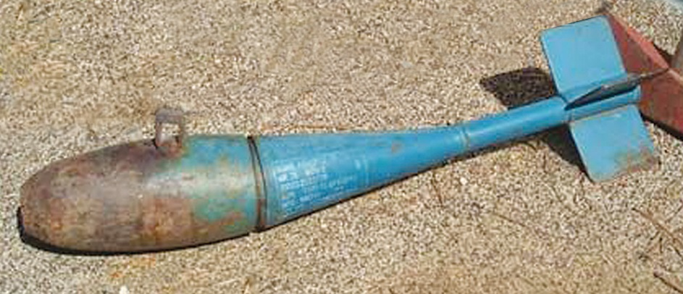
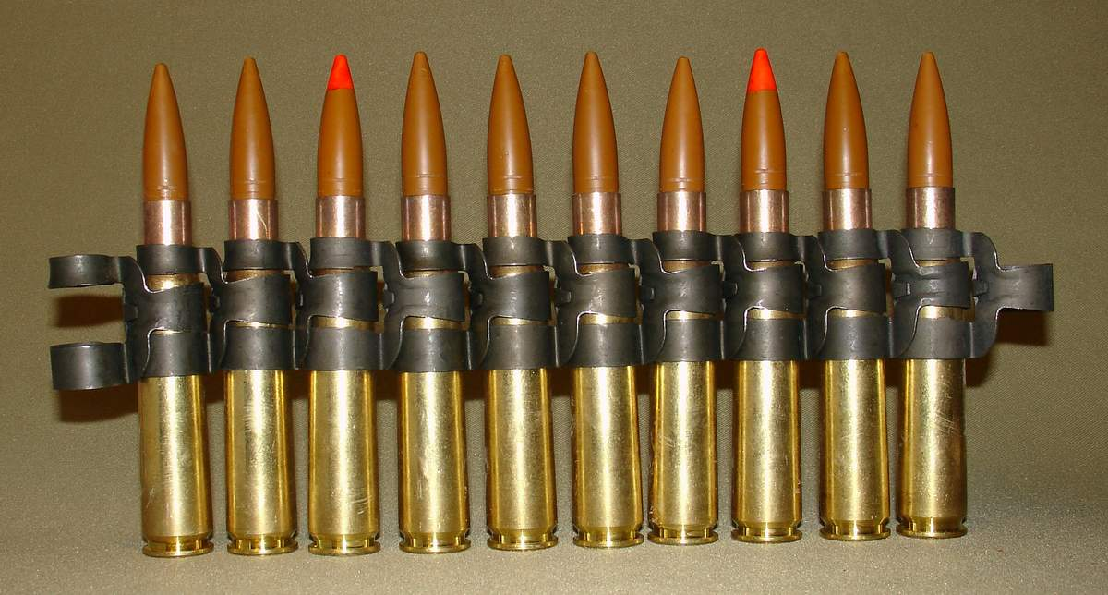
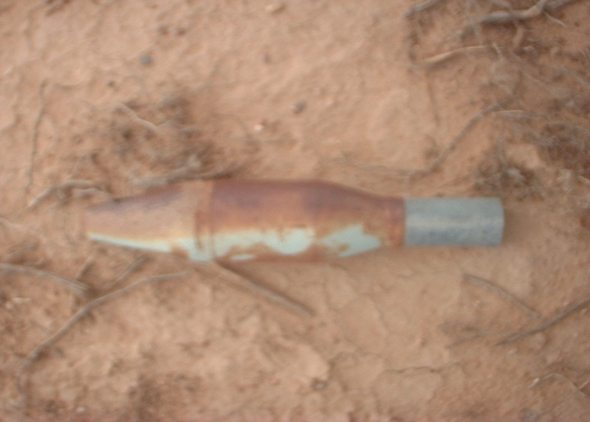
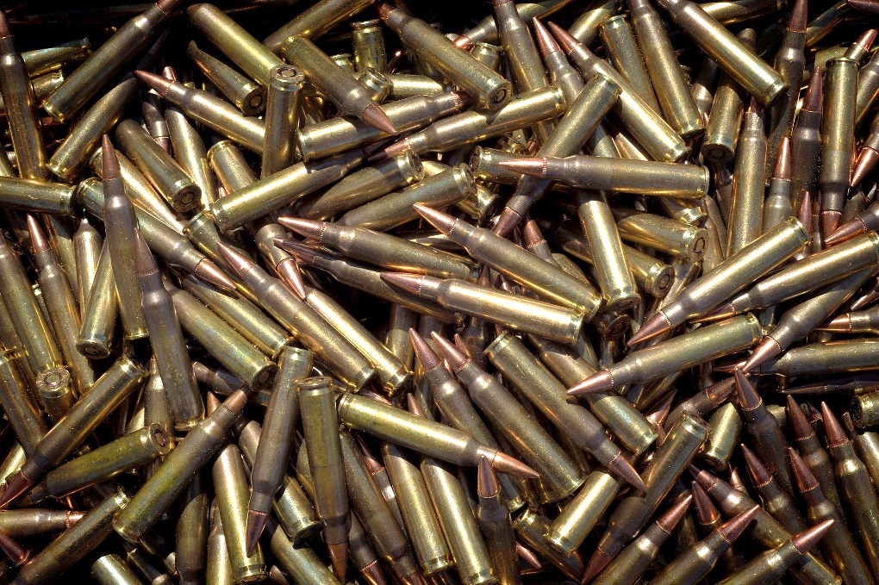
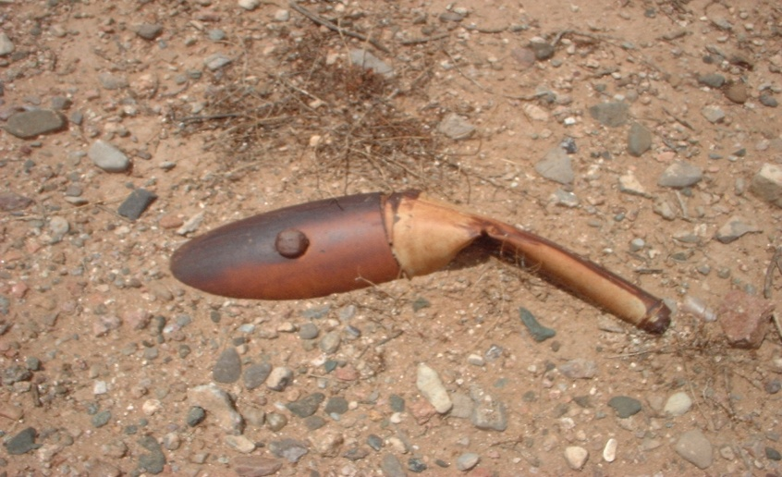
What is Ammo?
Ammo includes:
Mortar Rounds
Grenades
Bombs
Small Arms Ammunition
Notes:
Notes:
Ask: SGT Woof knows what ammo is. He wondered if you know what ammo is. Do you know what ammo is?
Ammo includes artillery projectiles, mortars, bombs, rockets, grenades, and bullets. Here are some pictures of different types of ammo.
Your parents, brothers, or sisters may use ammo. Ammo they may use for target practice or when hunting can be dangerous if not handled correctly, but this story isn’t about that kind of ammo.

Slide 5
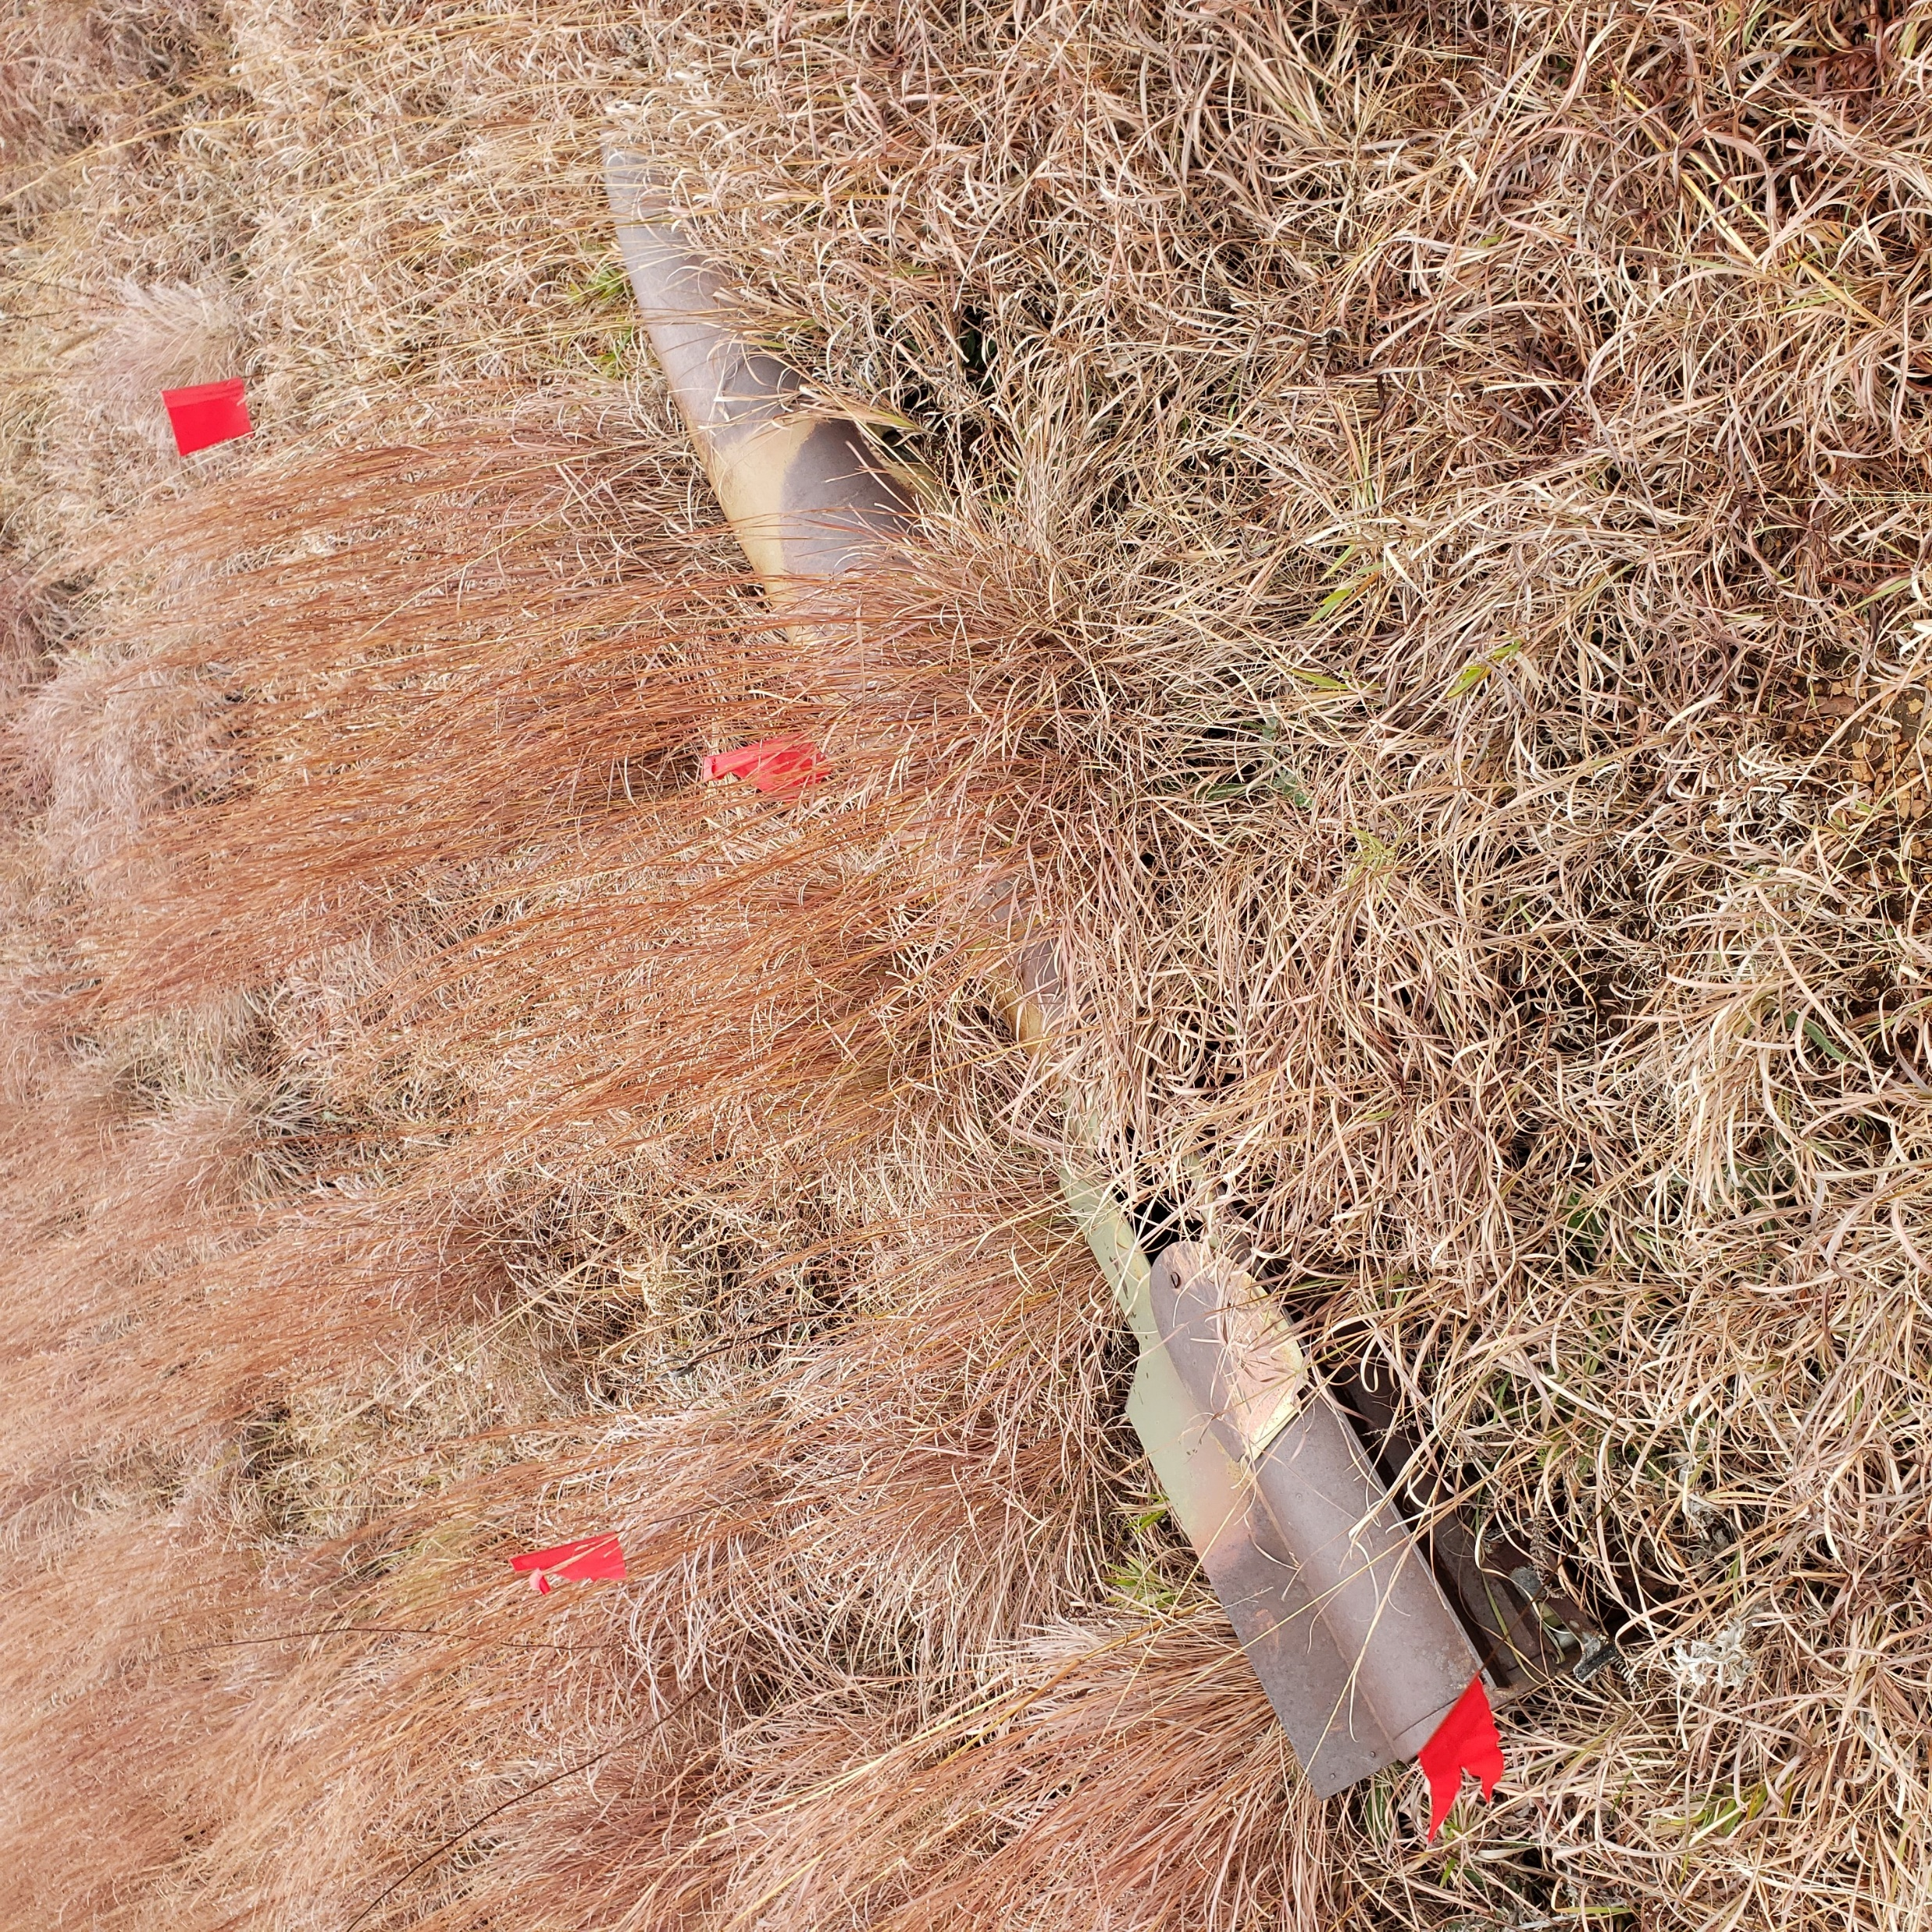
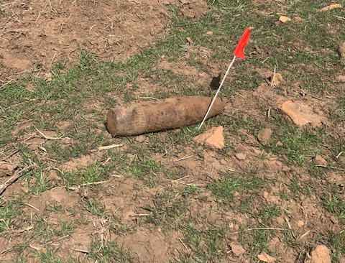
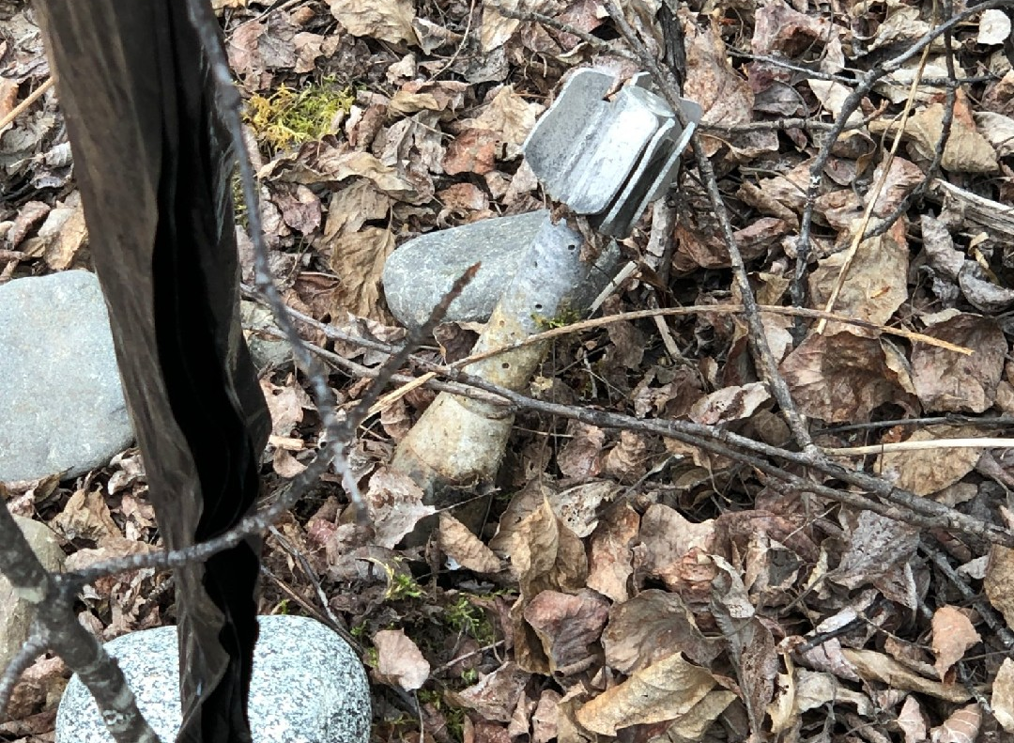
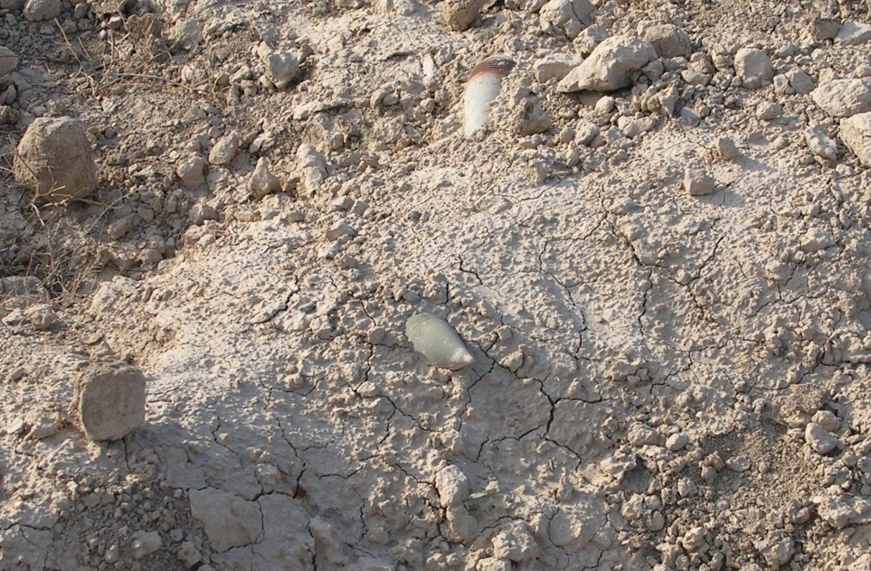
Some Ammo Is Hard To See
Photos: Sometimes they blend into the environment.

Slide 6
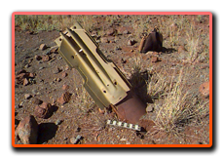
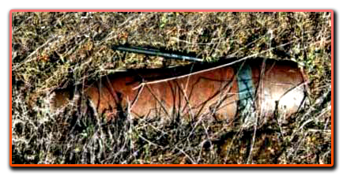
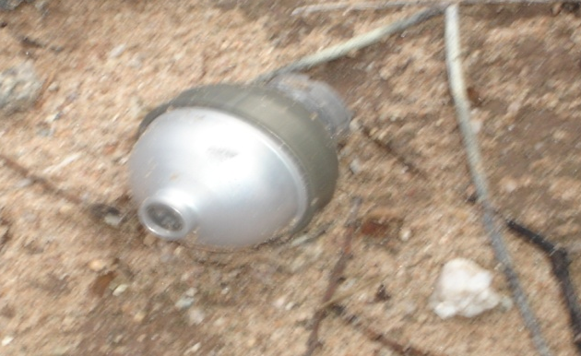
Ammo is dangerous
Ammo is dangerous!
Notes:
Notes:
Continue with story: SGT Woof knew that sometimes when soldiers practice with ammo, it does not work properly (explode). Did you know that?
When ammo doesn’t explode like it is supposed to, it is called unexploded ordnance or UXO. UXO may be an object fired from a tank, a bomb dropped from a plane, or a grenade thrown by a soldier.
SGT Woof knows that just because it did not work (explode) when it was used, does not mean it will not explode if approached, touched, moved, or disturbed. UXO can explode at any time, particularly if moved, handled, or disturbed. Did you know that?
Here are some pictures of UXO, unexploded ordnance.

Slide 7
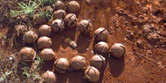

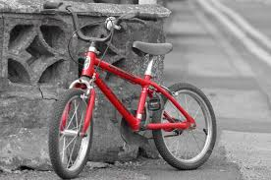
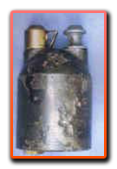
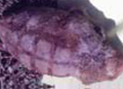

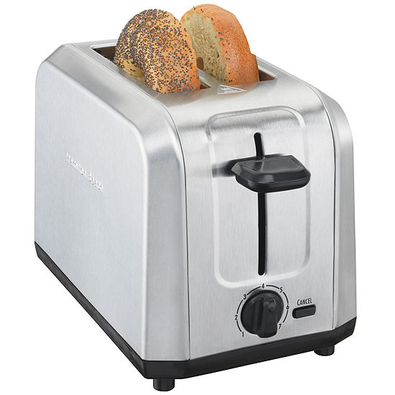
Can You Find the Ammo?
Notes:
Notes:
Be aware your audience are children, and their attention span is short. Stress the fact that there are different types of ammo, and do not look the same.
Ask: Can you find the pictures of ammo on this slide?
Answer: Point to each picture and ask if the picture looks like ammo. There are six pictures of ammo, described below, and four pictures that are not ammo (bananas, bicycle, toaster, Sergeant Woof).
Ask: What do you think would happen if you went near, touched, disturbed, or moved ammo you saw?
Answer: It might explode (“go off”) and could kill or injure you, your friends or your family.
Ask: Would you be able to recognize the items in these pictures as ammo?
Answer: (Probably not) These are items you may not have seen. Some look harmless, but they are not. See how some of these items look shiny, rusty, clean or dirty. One of the items is even stuck in the ground with one end sticking out.
Ask: Do you think you can recognize ammo of different types now?
Answer: No. You have been shown a lot of ammo, but there are many more. That is why you should never touch anything you think might be ammo. It takes an expert to identify every type of ammo.
There is no need to identify the ammo in the photos.
Below lists the ammo shown, in the event a student asks what each is.
Top row, left to right:
The first picture is of bomblets released from a missile or bomb. This type of ammo will detonate with almost any movement. Several people, and often people nearby, have been killed or injured when they disturbed it or attempted to pick it up.
The last picture is an artillery projectile. This type of ammo can destroy several rooms, even a house. Recently, several teenagers who removed one of these rounds from a military range to keep as a souvenir were killed when they dropped it.
Center row, left to right:
The center picture is a rifle grenade. Like a hand grenade, this type of ammo can be extremely dangerous when children or others disturb or handle it.
The last picture is a hand grenade. This type of ammo is very dangerous. Unfortunately, many people do not follow the 3Rs and take and keep this type of ammo as a souvenir. Handling this type of ammo has caused detonations that have killed or injured people who believed it safe.
Bottom row, left to right:
The center picture is a bomb. Like the projectile, it can destroy a house killing or injuring anyone nearby. Some contain chemical agents that can kill or injure people nearby and even blocks away.
The last picture is a rocket. Like most of the other ammo shown, should you be close to it when it detonates, you would most likely be injured or killed.

Slide 8
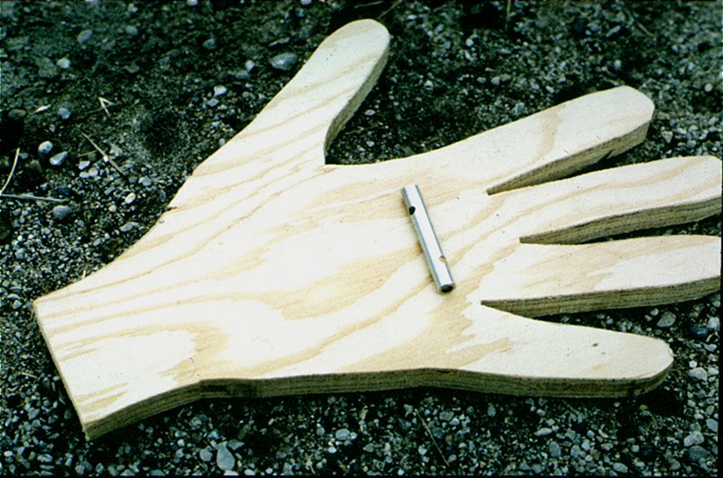
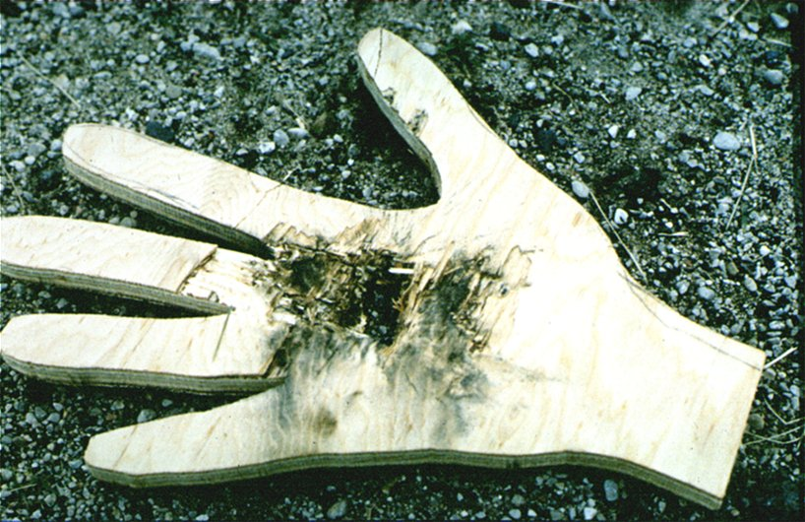
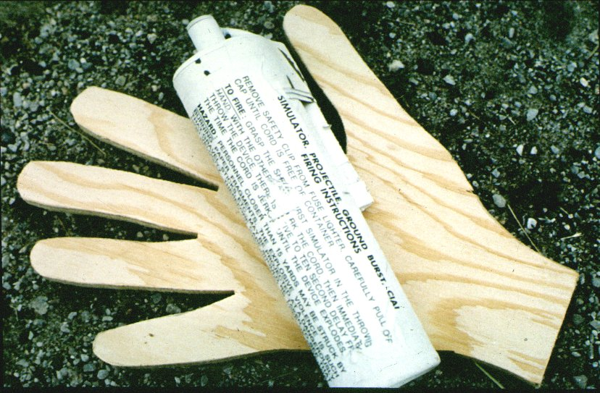
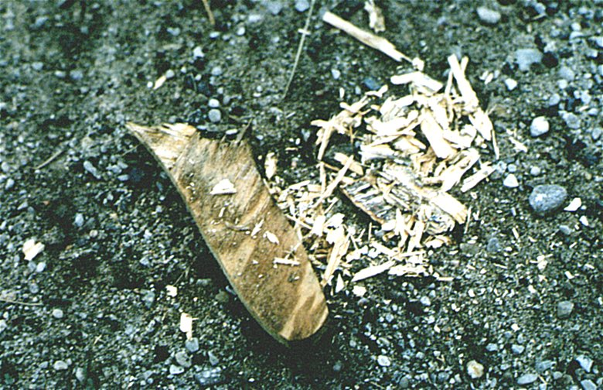
Sergeant Woof Recognizes the Danger!
Ammo is dangerous!
Notes:
Notes:
Explain: When SGT Woof saw what he thought was ammo, he recognized it was dangerous. He wants you to recognize the danger too.
These photos show what two different types of ammo can do if they explode in a person’s hand. (Point out the before and after photos so children see the result of the explosion on the wooden hand.)

Slide 9
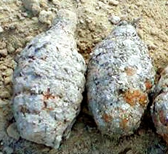
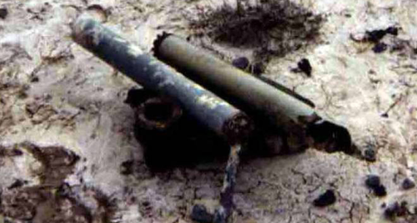
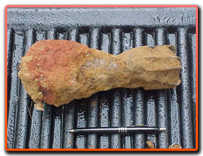
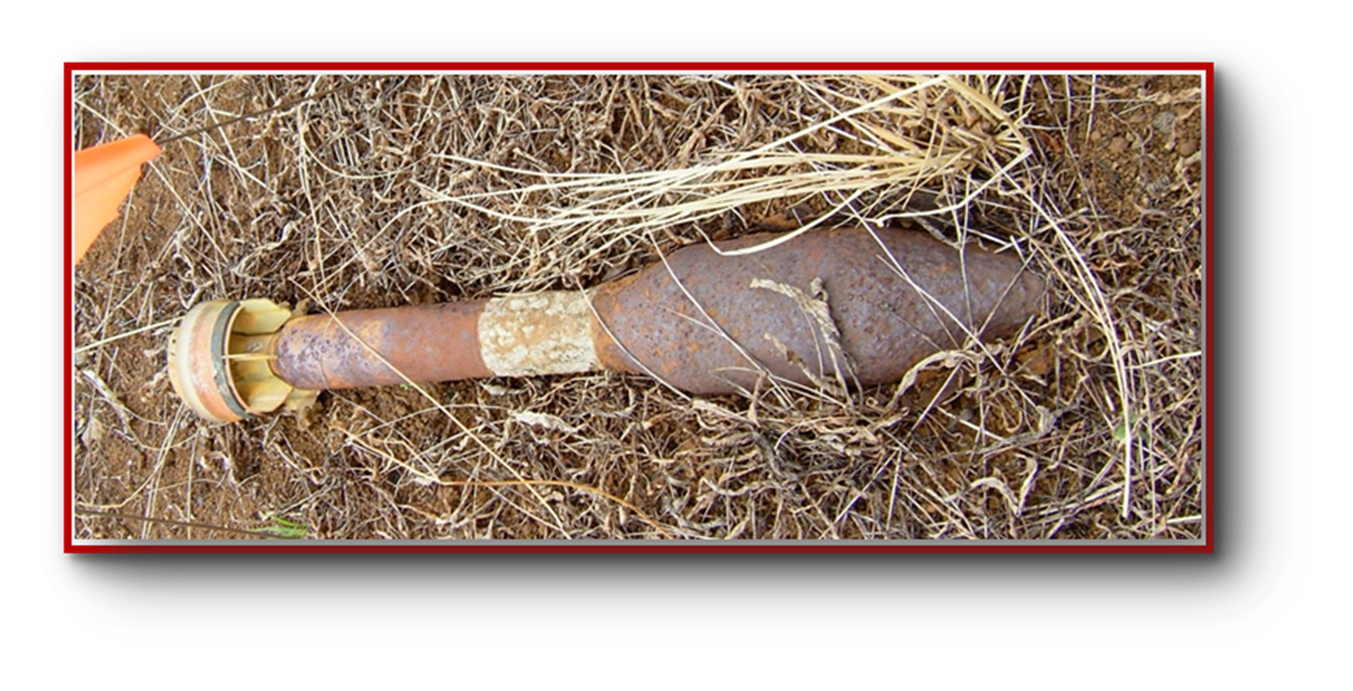
Condition of Ammo
Ammo may be hard to identify.
It may be clean, rusty, or dirty looking; or
It may be whole or in parts.
Notes:
Notes:
Explain: SGT Woof wants you to know that ammo may be hard to identify. Ammo:
May be clean, rusty, or dirty looking; or
May be whole or in parts.
Here are some pictures of ammo seen outside. As you can see, ammo can be very difficult to recognize as ammo after is has been outside. That is the reason it is very important not to pick up anything that you know, or think, may be ammo.

Slide 10
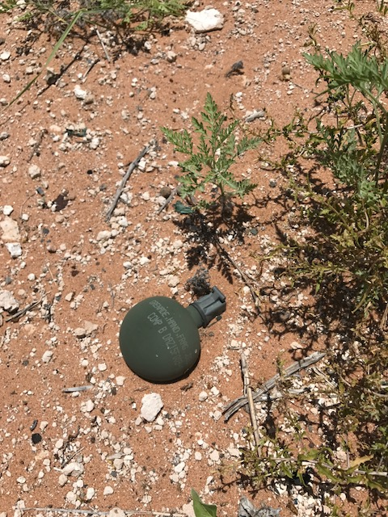
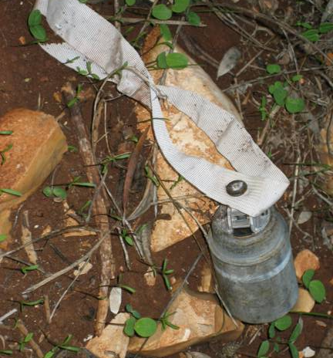
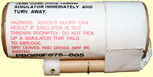
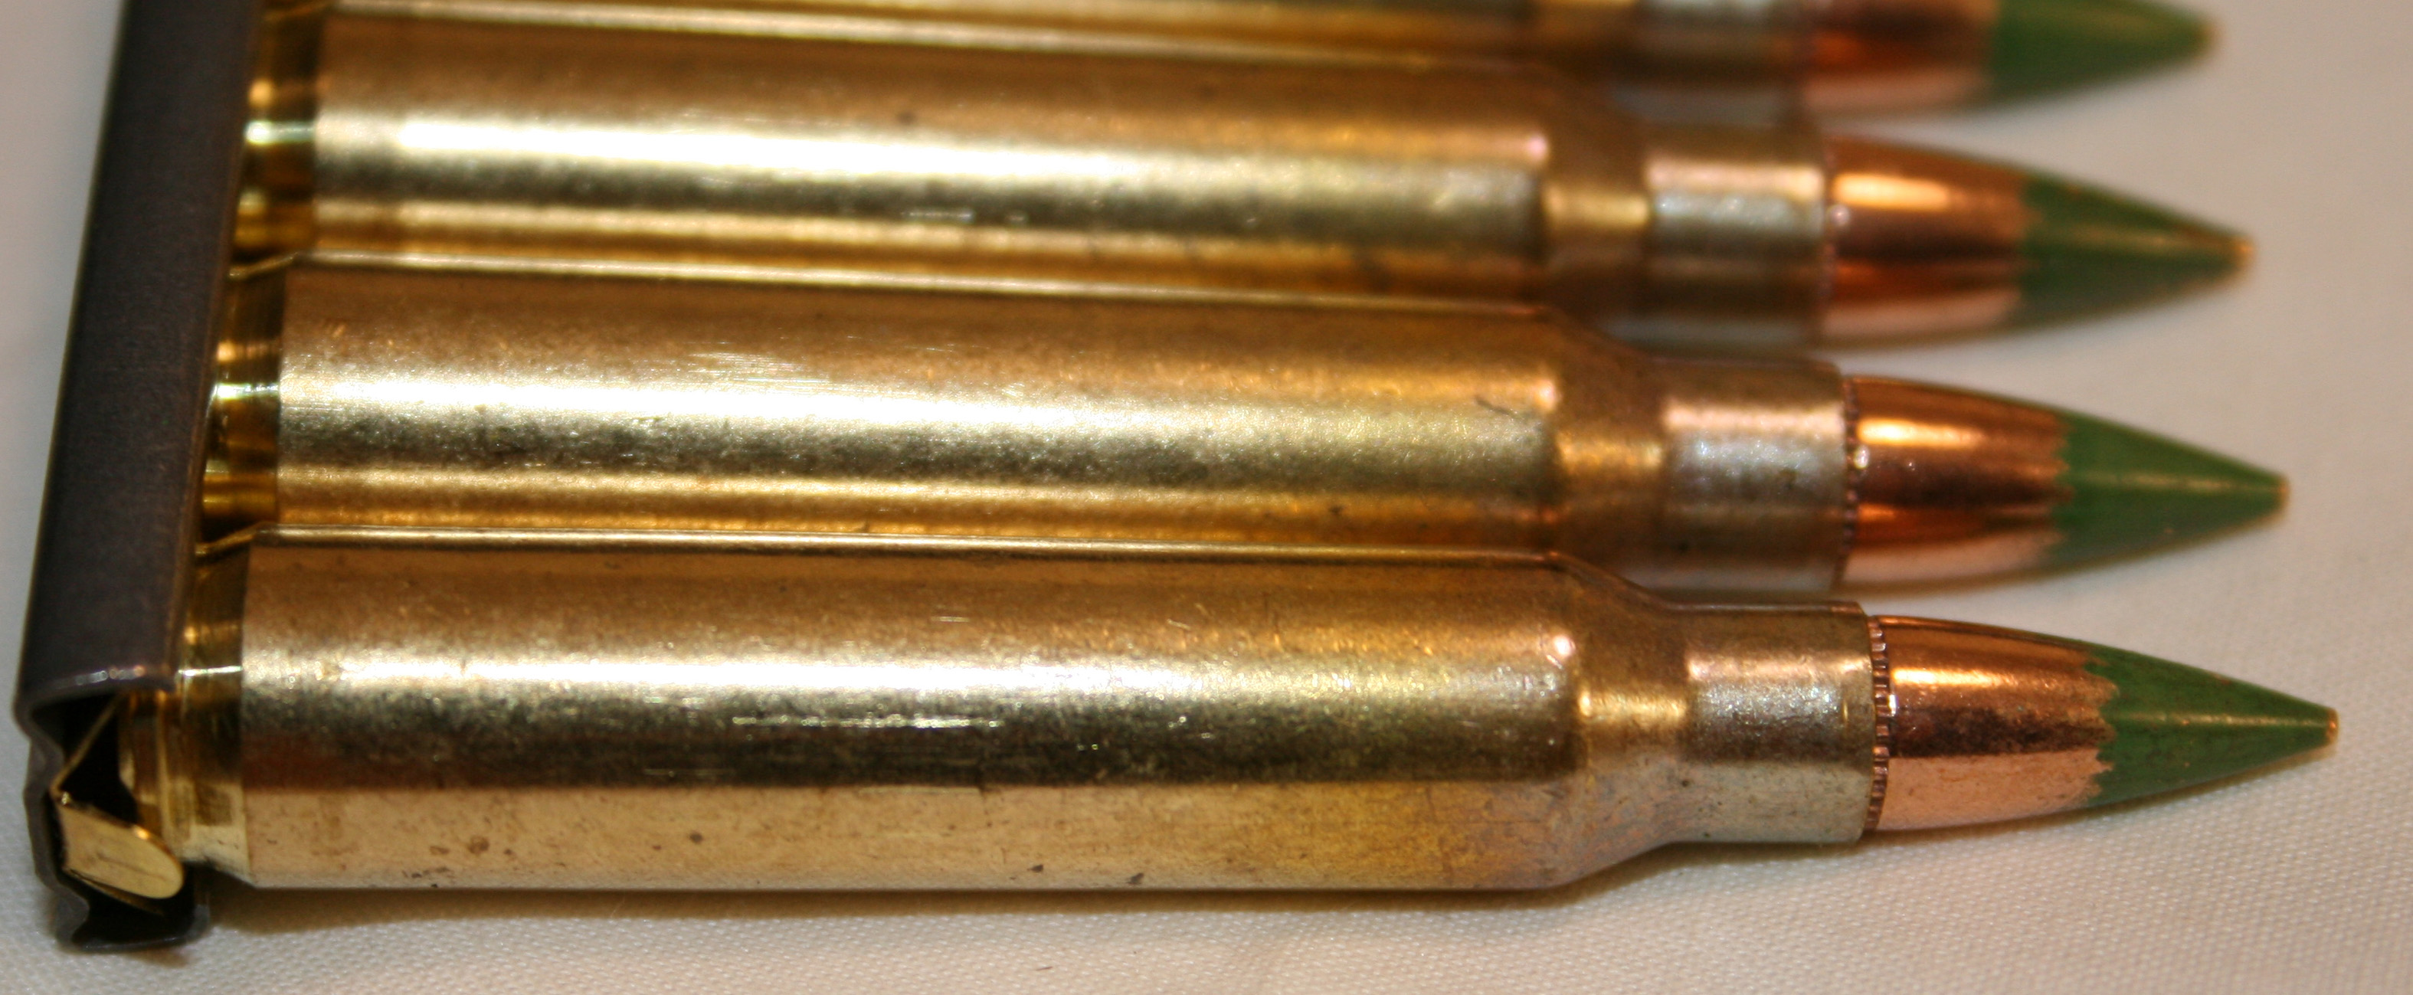
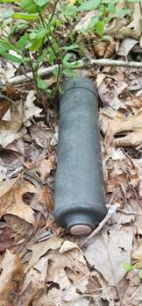
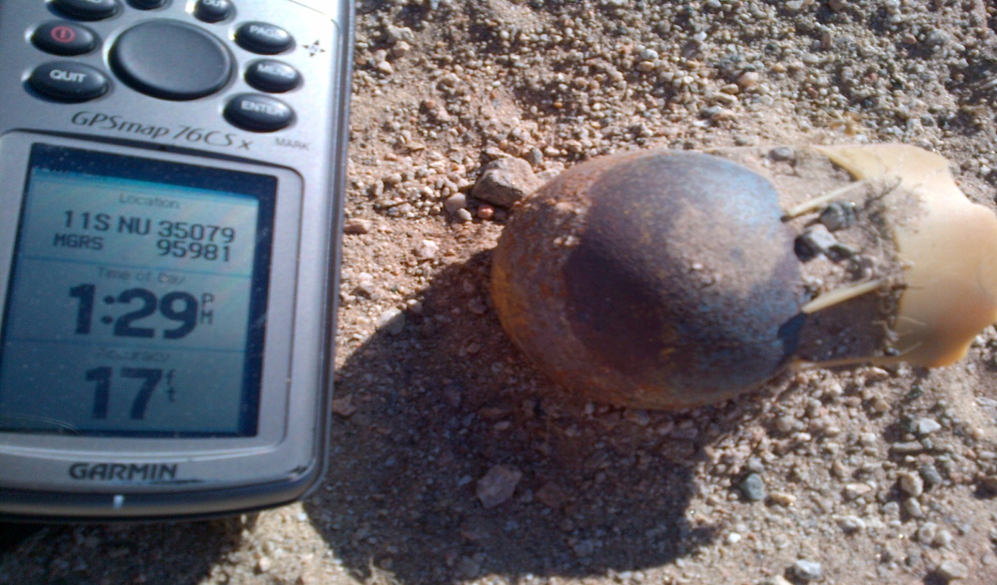
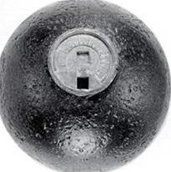
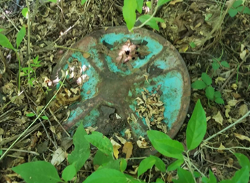
Ammo has Many Shapes, Sizes and Types
Ammo comes in many shapes and sizes.
Notes:
Notes:
Explain: SGT Woof also wants you to know that ammo comes in many shapes, sizes, and types.
SGT Woof wants you to know that ammo, even cannon balls, can still be dangerous after being handled or kept as souvenirs for years. Collecting or keeping ammo as a souvenir is extremely dangerous because it still may explode! Many children have been killed or seriously injured when playing with or handling ammo that they or someone else thought was safe.
Here are some pictures of different types of ammo. Do you see the cannon ball?

Slide 11

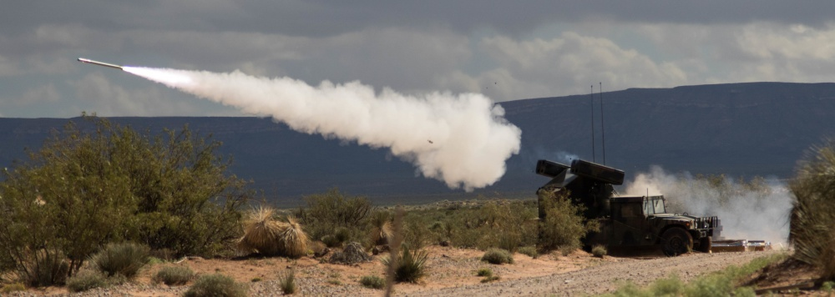
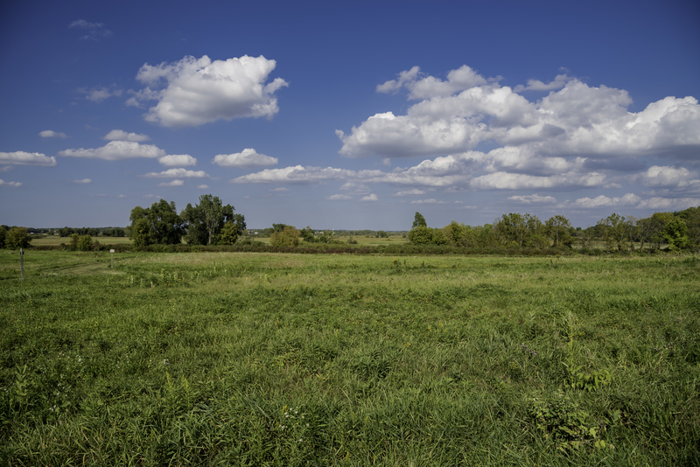
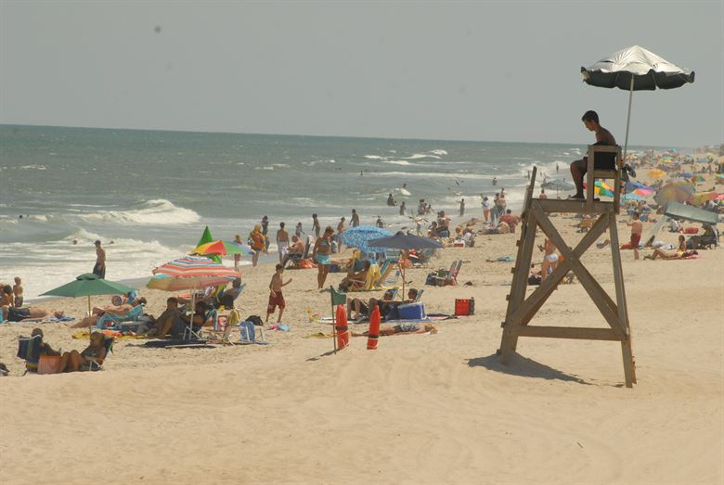

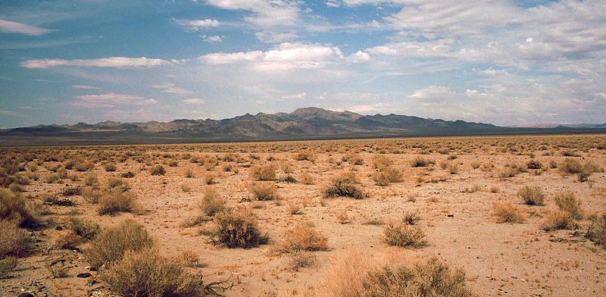
Where Can You Find Ammo?
Ammo can be found anywhere.
Photo credit: SSG Jarred Woods
Photo credit: Sean O’Flaherty
Photo credit: SSG Jarred Woods
Notes:
Notes:
Explain: You are most likely to see ammo at a military base in areas where soldiers train, but you could see ammo anywhere. **Feel free to replace pictures with installation specific pictures.
Go through each photo and ask students if they think ammo could be found in each location.
Ask: Do you think ammo could be found here?
Answer: Yes to all photos. Most ammo is found at military bases in areas where soldiers train (photo of missile firing), but sometimes ammo can be found in other places.
Ammo has been found in the ocean and along beaches.
Ammo can be found in the woods.
Ammo has been found in houses and neighborhoods.
Ammo has been found in fields.
Ammo can be found in the desert.

Slide 12
Sergeant Woof Sees Ammo!
I went for a walk and saw this. What should we do?
Follow the 3Rs!!
Notes:
Notes:
Continue with story: While he was walking, SGT Woof saw something that looked like ammo. He recognized it could be dangerous!

Slide 13
Sergeant Woof Follows the 3Rs!
Notes:
Notes:
Ask: What did SGT Woof say the 3Rs stand for?
Answer: The 3Rs stand for:
Recognize - when you may have seen ammo and that ammo is dangerous
Retreat – do not get near, touch, move, or disturb ammo; carefully leave the areas – do not run
Report – tell your parents or a teacher what you saw and have them call the police

Slide 14

Sergeant Woof Recognizes that it may be Ammo!
Recognize that it may be ammo and that ammo is dangerous.
Notes:
Notes:
Continue with the story: When SGT Woof thought he saw ammo, he knew it was important to RECOGNIZE that ammo is dangerous.

Slide 15

Sergeant Woof Retreats from the Danger!
Retreat - do not go near, touch, move, or disturb ammo; carefully leave the area. Do not run.
Notes:
Notes:
Continue with the story: When SGT Woof thought he saw ammo, he knew it was important that he did not go near, touch, move, or disturb it. So, he carefully left or retreated. He carefully left the area by the same path from which he came. He did not run because he knew that if you run, you could trip and get hurt or you could fall on other ammo that may be in the area and get hurt or killed.

Slide 16

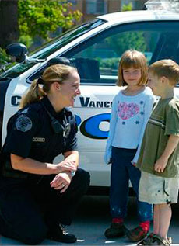
Sergeant Woof Reports the Danger!
Report - Tell your parents or a teacher what you saw and have them call the police.
Notes:
Notes:
Continue with story: Once he retreated from the ammo, SGT Woof knew it was important to report what he saw! He knew he could tell a parent or a teacher about it and ask them to call the police. The first trusted adult he found was a police officer, so he told the police officer. If you saw ammo, you could also tell other people you know, like a grandparent, a friend’s parent, a principal, or a fireman, but never a stranger.
Once SGT Woof reported what he saw, the police asked for assistance from Range Operations personnel. These soldiers, who are highly trained, looked at the item and determined what to do with it.
By reporting what he saw, SGT Woof helped keep everyone safe.

Slide 17

Sergeant Woof says, “Help keep everyone safe by following the 3Rs!”
Recognize - when you may have seen ammo and that ammo is dangerous.
Retreat – do not go near, touch, or disturb ammo; carefully leave the area. Do not run.
Report – tell your parents or a teacher what you saw and have them call the police
Notes:
Notes:
Continue with story: Once he retreated from the ammo, SGT Woof knew it was important to report what he saw! He knew he could tell a parent or a teacher about it and ask them to call the police. The first trusted adult he found was a police officer, so he told the police officer. If you saw ammo, you could also tell other people you know, like a grandparent, a friend’s parent, a principal, or a fireman, but never a stranger.
Once SGT Woof reported what he saw, the police asked for assistance from Range Operations personnel. These soldiers, who are highly trained, looked at the item and determined what to do with it.
By reporting what he saw, SGT Woof helped keep everyone safe.

